Slide 1


2nd International Conference on GPM for Personality Disorders
Karolinska Institutet • 5 May 2026
General Psychiatric Management for
Adolescents With BPD —
Brazilian Implementation
GPM-A
Marcos S. Croci, MD | Marcelo Brañas, MD, PhD
• Co-directors, ADRE-USP
• Collaborators, GPDI, McLean Hospital
Notes:
[Croci opens, 15 s] Thanks for the invitation. Marcelo Brañas and I will talk about implementing GPM-A at a Brazilian tertiary-care outpatient clinic and residency training program. I'll cover our context and the clinical program. Marcelo will cover challenges, dissemination, and what we've learned.

Slide 2
Disclosures
Financial conflicts of interest
Marcos S. Croci, MD
Marcelo Brañas, MD, PhD
No personal financial conflicts of interest.
No personal financial conflicts of interest.
Both authors receive royalties from Manole Publisher (unrelated to this work; section editors of clinical psychiatry textbooks).
GPM-A • 2 / 33
Notes:
[~15 s, joint] Neither of us has personal financial conflicts to declare. We both receive unrelated royalties from Manole Publishers — editorial work on clinical psychiatry textbooks, nothing tied to GPM.

Slide 3

Why?
Ibirapuera Park · São Paulo
Notes:
[~5 s, Croci] Why does this matter?

Slide 4
The scale of the problem in Brazil
A population-level demand that specialist care cannot meet
Demand
Supply
6.8% any PD in São Paulo (Santana et al., 2018)
1.8% BPD in São Paulo (BHRC*)
20–30% of outpatient mental-health attendees · 35–40% in CAPS
Brazilian High-Risk Cohort: ~20% BPD among severely symptomatic young adults
17.4% adolescent NSSI rate (Angelo, Pan, Miguel, Brañas & Croci, 2026, in submission)
6.39 psychiatrists per 100,000 — OECD average 17.83 (Scheffer et al., 2025)
61.4% of psychiatrists concentrated in state capitals
~1.25 DBT therapists per 10,000 people with BPD
Mental health = 2.54% of the health budget (WHO recommends 5%)
80% treatment gap — specialist-led BPD care is unreachable for most Brazilians who need it.
Santana et al., 2018 · Scheffer et al., 2025 · Angelo et al., 2025 (in submission)
GPM-A • 4 / 33
Notes:
[~90 s, Croci] The scale of what we're trying to treat in Brazil. On the demand side — Santana and colleagues, 2018, found 6.8% prevalence of any personality disorder and 1.8% BPD in a São Paulo megacity survey. In outpatient mental-health services 20 to 30% of patients meet BPD criteria; in CAPS — the community mental-health centers — it's 35 to 40%. The Brazilian High-Risk Cohort found about 20% BPD among severely symptomatic young adults. And adolescent NSSI runs at 17.4% from our own analysis, currently in submission. On the supply side — Scheffer and colleagues, 2025, put Brazil at 6.39 psychiatrists per 100,000 people, against an OECD average of 17.83. 61.4% of those psychiatrists are concentrated in state capitals. DBT-trained therapists are roughly 1.25 per 10,000 people with BPD. And mental health receives 2.54% of the health budget — WHO recommends 5%. The gap is close to 80%. Specialist-led BPD care is unreachable for most Brazilians who need it — and that is what makes a generalist model necessary, not optional.

Slide 5
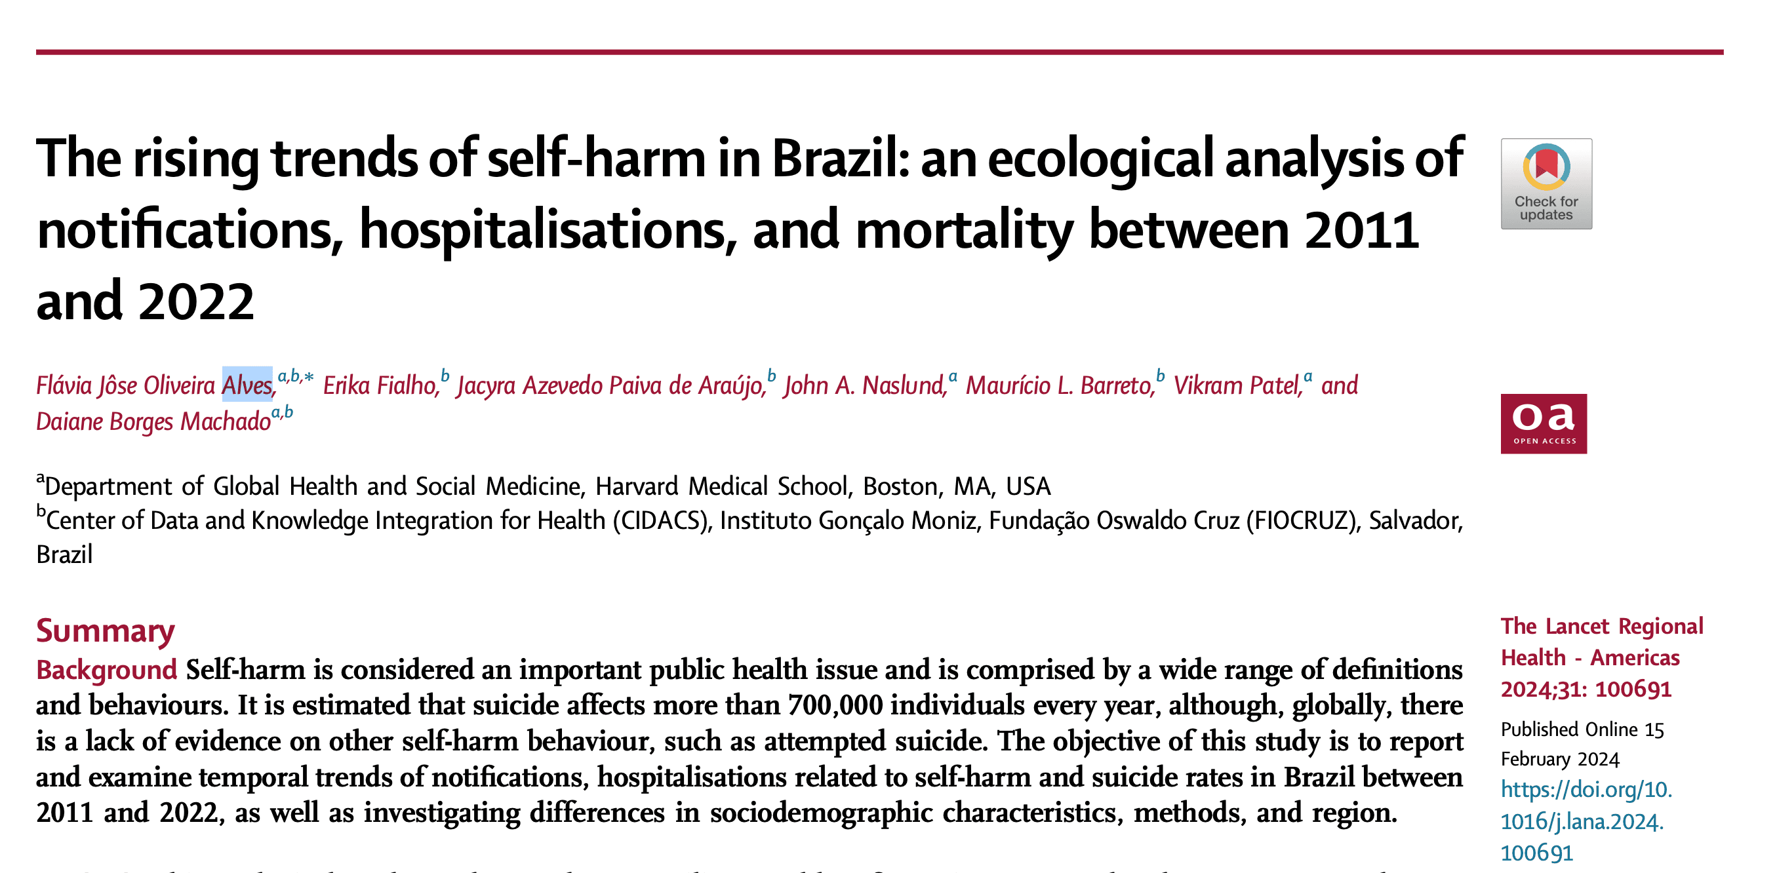
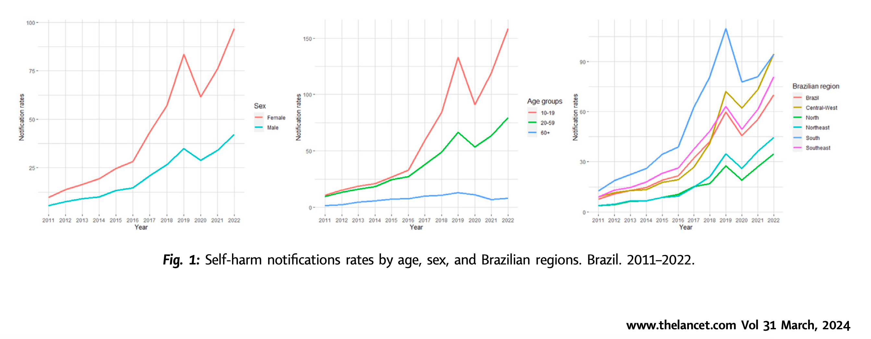
Self-harm in Brazil: Rising Trends
Population-level evidence from recent health information system data
Alves et al., 2024
GPM-A • 5 / 33
Notes:
[~45 s, Croci] And the problem is accelerating. Alves and colleagues, 2024, pulled self-harm notifications, hospitalizations, and mortality from the Brazilian health information system between 2011 and 2022. The rates are rising across age groups, with the steepest increases in adolescents and young adults. This is the population-level backdrop for everything we do clinically — not a static problem, a growing one.

Slide 6
Brazilian healthcare — two parallel systems
Most professionals work in both
Public — SUS
Private
Entirely free at point of service
for any person — including foreigners
Primary, secondary, and tertiary
levels of care
Tertiary care = HC-FMUSP / ADRE
Insurance-based
offered by employers or purchased individually
Out-of-pocket
access to private hospitals, labs, and clinics
Specialist BPD care is almost entirely private
Healthcare professionals usually work in more than one system
GPM-A • 6 / 33
Notes:
[~60 s, Croci] Brazilian healthcare runs as two parallel systems. SUS is entirely free at point of service for anyone — including foreigners — and covers primary, secondary, and tertiary care. Private care runs through employer or individually-purchased insurance. Most professionals work in both. Tertiary-care BPD treatment is almost entirely in academic public institutions — which is where ADRE sits.

Slide 7
BPD adolescents scatter — myths block proper care
Patients fall between clinics while institutional beliefs delay treatment
Scattered across clinics
Institutional myths
• Patients migrate between symptoms and clinics
• Mood, impulsivity, and substance-use labels obscure BPD
• No coherent framework for BPD's core symptoms
• Frequent, unnecessary, prolonged hospitalizations
✗ “Can't diagnose BPD in adolescents”
✗ “BPD is untreatable”
✗ “Let them mature by themselves”
✗ “General training is enough to treat BPD”
Delaying well-informed BPD care worsens long-term outcomes — we need a curriculum update.
Unruh & Gunderson, 2016 · Ilagan & Choi-Kain, 2021
GPM-A • 7 / 33
Notes:
[~90 s, Croci] Two intertwined problems explain why BPD adolescents don't get proper care. First — they scatter across other clinics. Without a coherent BPD framework, they get labeled by whatever symptom dominates at the moment: mood disorder here, impulsivity there, substance use somewhere else. They migrate from service to service and accumulate frequent, unnecessary, sometimes prolonged hospitalizations. Second — institutional myths persist. That you can't diagnose BPD in adolescents. That BPD is untreatable. That they'll mature on their own. That general training is sufficient. These myths delay well-informed care, and Ilagan and Choi-Kain have shown that delay worsens long-term outcomes. The conclusion Unruh and Gunderson drew — and the conclusion we draw — is that we need a curriculum update.

Slide 8
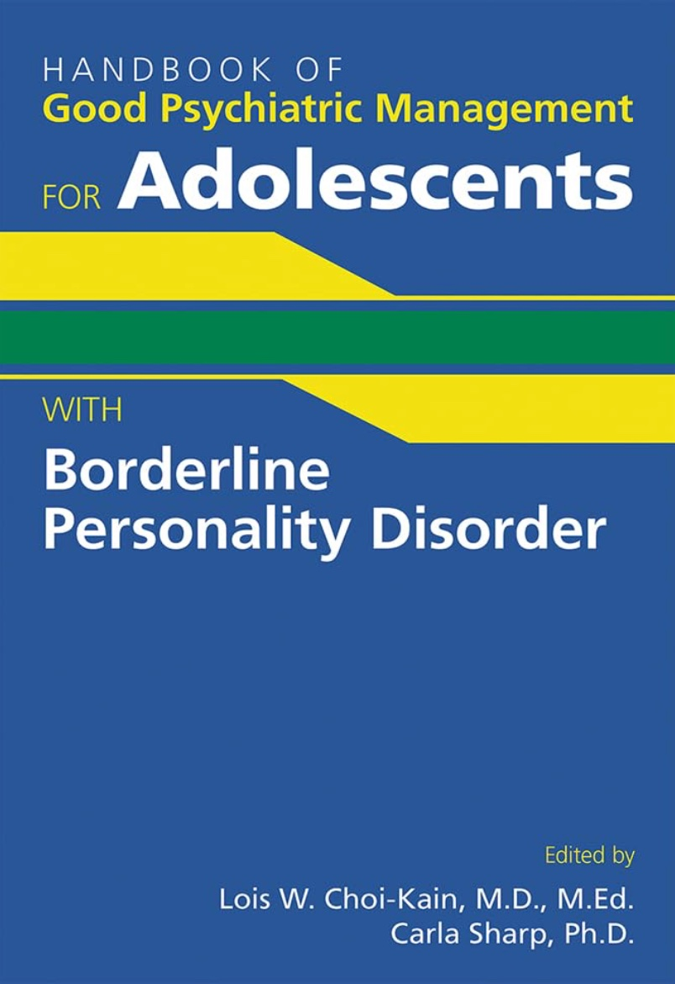

Generalist models needed — and now available
Theory, clinical manual, and Portuguese translation make GPM-A deliverable in Brazil
Clinical manual
Portuguese translation
Choi-Kain & Sharp, Eds.
APA Publishing, 2024
Hogrefe (Brazilian ed.)
Handbook of Good Psychiatric Management for Adolescents with Borderline Personality Disorder — the training text behind GPM-A implementation.
Manual do bom manejo clínico para adolescentes com transtorno de personalidade borderline — removes the language barrier for SUS-wide dissemination.
A clinical manual and a Portuguese translation — GPM-A is ready for Brazilian implementation.
GPM-A • 8 / 33
Notes:
[~60 s, Croci] The good news is that generalist options now exist in a form we can actually use in Brazil. Ilagan and Choi-Kain published the foundational paper in 2021 — Current Opinion in Psychology — introducing GPM-A as a generalist adaptation for adolescents, "good enough" for most young people at the critical developmental window. Choi-Kain and Sharp then brought out the full clinical handbook with APA Publishing — that's the training text we use for every resident. And Hogrefe's Brazilian edition removed the language barrier — residents, supervisors, and families can all read it in Portuguese. Theory, manual, and translation — three things that have to be in place before any implementation effort makes sense. They all are. Which is why we started.

Slide 9
Why generalist-first — and why GPM-A
At population scale, only structured generalist care can reach most patients
Why generalist-first
Why GPM-A among generalist options
• As effective as EBTs — structured generalist care is non-inferior to CAT and DBT-A
Ilagan & Choi-Kain, 2021
• Feasible workforce — deliverable by general-psychiatry residents under supervision
Unruh & Gunderson, 2016
• Sustainable cost — less resource-intensive than specialist EBT programs
Choi-Kain, 2016
• Public-system fit — built for nationwide, SUS-style dissemination
Gunderson, 2016
• Common language — shared framework across therapy schools (DBT, MBT, TFP, psychodynamic)
Kramer et al., 2017
• One clinician, one relationship — meds and therapy integrated in the same dyadic frame
• Function over symptoms — school, relationships, and daily life as treatment targets
GPM-A • 9 / 33
Notes:
[~90 s, Croci] Why a generalist-first approach, and specifically GPM-A. Three reasons for generalist care. Structured, high-quality generalist care is comparable to specialized treatments like CAT and DBT-A — Ilagan and Choi-Kain, 2021. It's advantageous when delivered by non-specialist residents — Unruh and Gunderson, 2016. And it's less resource-intensive — Choi-Kain, 2016 — which matters enormously in public healthcare. Now why GPM-A specifically. Gunderson, 2016, argued it is optimal for nationwide dissemination in a public system. Kramer and colleagues, 2017, showed it provides a common language across professionals and different therapy schools. It includes integrated medication management, which saves resources. And it focuses on functionality — school, relationships, daily-life situations — not only symptom reduction.

Slide 10
GPM-A — eight basic principles
1
2
3
4
Early diagnosis
is routine
Psycho-
education
Be active,
not reactive
Focus on life
situations
Lower threshold to 3+ DSM-5 criteria
Patient, family, school, peers
Role-model “thinking first”
School, work, relationships
5
6
7
8
Real &
professional relationship
Change is
expected
Foster
accountability
Ensure family
involvement
Dyadic; balance splitting
Re-examine if not improving
Own actions; learn from mistakes
Alliance; crisis management
Today's question: what does it take to deliver this in a Brazilian tertiary-care public setting?
GPM-A • 10 / 33
Notes:
[~45 s, Croci] Brisk recap — most of the audience knows GPM. The GPM-A book lays out eight basic principles. Early diagnosis should be routine, with the threshold lowered to three or more DSM-5 criteria in adolescents. Psychoeducation for patients, families, schools, and peers. Be active — role-model thinking-first rather than reactivity. Focus on life situations: school, work, relationships. The therapeutic relationship is real and dyadic as well as professional. Convey that change is expected — if the patient isn't improving, examine why. Foster accountability — patients own their actions and learn from mistakes. And ensure family involvement. Today's question: what does it take to actually deliver this in a Brazilian tertiary-care public setting?

Slide 11
GPM-A — five key adaptations from GPM
Driver: BPD as a public-health imperative — 11–22% of adolescent outpatients, 33–49% of inpatients (Chanen et al. 2017)
1
Subthreshold inclusion
≥3 BPD criteria suffice (vs. full-criteria adult diagnosis)
2
Age-appropriate language
Relatable framing for psychoeducation; three developmental scripts (younger / mid / older teens)
3
Amplified family involvement
Family is structural, not adjunctive — confidentiality, mediation, sibling support, mandated reporting
4
Time-limited treatment
Shortened, planned termination — avoid interrupting normative developmental trajectories
5
Explicit developmental focus
Identity formation, school engagement, autonomy, peer relationships
Aligned with DSM-5 AMPD / ICD-11 · Preserves GPM core: “good enough,” “getting a life,” interpersonal hypersensitivity
GPM-A • 11 / 33

Slide 12
GPM-A — operational specifics
Family, crisis, multimodal village, planned ending — and updated clinical content
Structural process
Updated clinical content
• Age-modulated disclosure — three developmental scripts (parents-first, family-together, adult-style)
• Family is structural — confidentiality, mediation, sibling support, mandated reporting
• Dyadic crisis planning — parent coping plan alongside patient safety plan; restrict lethal means
• Multimodal “village” — school counselors, college MH, extracurriculars partly substitute for group therapy
• Planned ending — time-limited termination, boosters, annual check-ups; teens leave with anxiety, not mourning
• NSSI — mean onset 13 yrs; sleep & social-media contagion as modifiable risks
• School & college — accommodations, transitions; group matching by narrow age bands (12–14, 15–17)
• FINE cue — “Feelings I'm Not Expressing” —actively challenge passivity
• ADHD comorbidity — 38% in adolescents vs. 14% in adults; treat as you would without BPD
GPM-A • 12 / 33

Slide 13
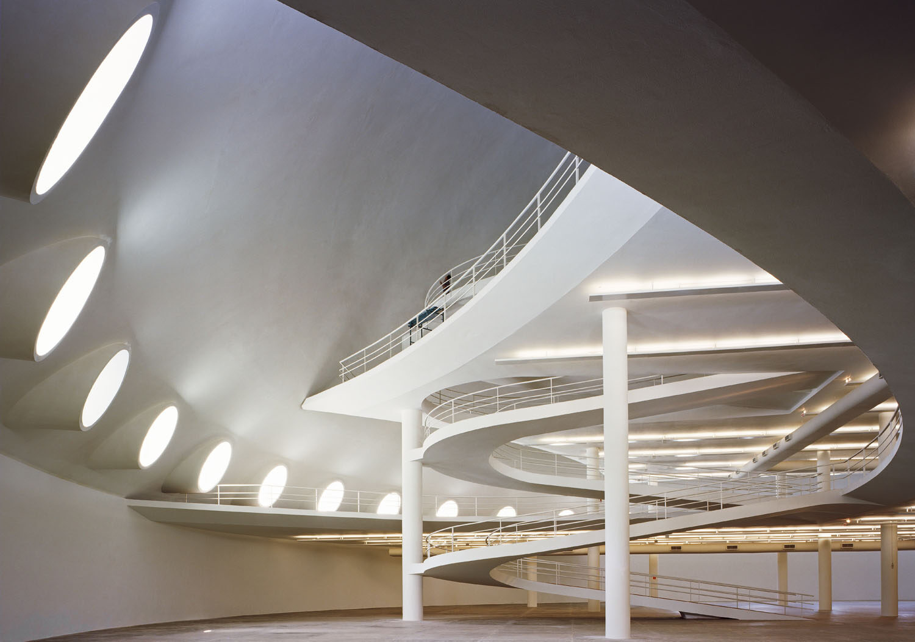
The ADRE program
Oca · Ibirapuera Park
Notes:
[~5 s, Croci] Now — how we actually built and run this kind of clinic inside a public teaching hospital.

Slide 14
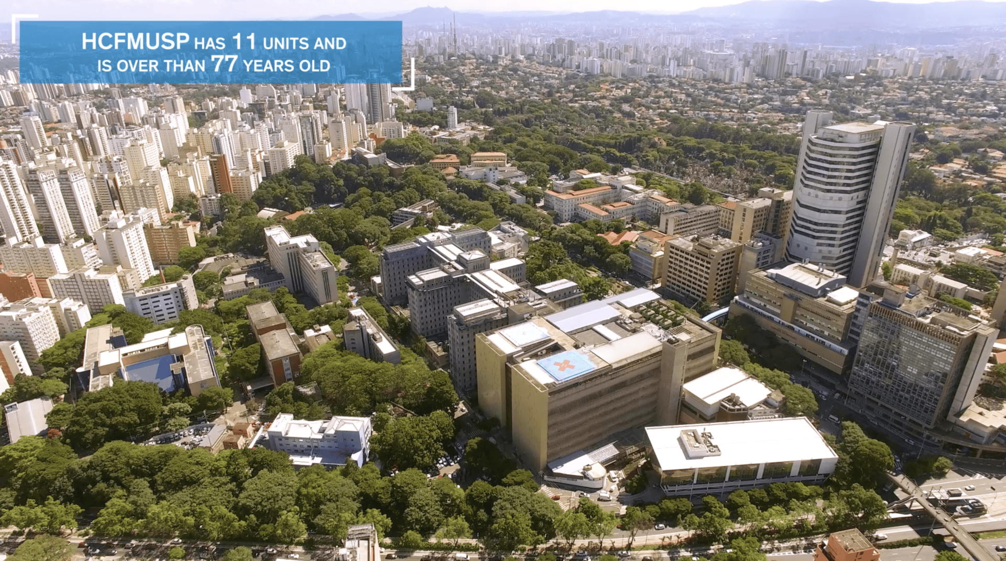
University of São Paulo · Hospital das Clínicas
The largest university-hospital complex in Latin America
HC-FMUSP
Teaching, research, and specialized care — the reference tertiary-care center for the state
Institute of Psychiatry (IPq)
Hosts the Department of Child & Adolescent Psychiatry
ADRE
Adolescent BPD outpatient program — embedded in residency training
GPM-A • 14 / 33
Notes:
[~60 s, Croci] USP Medical School and its teaching hospital, Hospital das Clínicas, make up the largest academic-medical complex in Latin America. Within it, the Institute of Psychiatry hosts our Department of Child and Adolescent Psychiatry — which is where ADRE lives, embedded in residency training.

Slide 15
Adolescent BPD Outpatient Program (ADRE)
Tertiary-care clinic embedded in a residency training program
1
Embedded
Sits inside the Department of Child & Adolescent Psychiatry at IPq-HC-FMUSP
2
Tertiary referral
Complex*, comorbid adolescent cases referred other clinics at USP and secondary services
3
Dual mission
Clinical care for moderate/severe cases + residency training for the next generation
GPM-A • 15 / 33
Notes:
[~60 s, Croci] ADRE is the Adolescent BPD Outpatient Program — a tertiary-care clinic embedded in the Department of Child and Adolescent Psychiatry at IPq-HC-FMUSP. We receive complex, comorbid referrals from across Brazil. Our dual mission is clinical care for severe cases and residency training for psychiatrists who will go on to work elsewhere in the public system.

Slide 16
ADRE pathway — referral, screening, treatment
Adolescents 13–17 y/o enter through a structured 6–12 month program
1
By Referral
2
Initial Screening
3
Treatment
▪ Secondary public psychiatric services in São Paulo
▪ Other clinics at the Psychiatry Institute at USP
▪ Children’s & Adolescents’ Institute at USP
▪ Zanarini’s Childhood Interview for BPD (CI-BPD)
▪ Psychiatric interview by senior staff
▪ Weekly GPM-A sessions
▪ 6–12 months duration
▪ Stepped-care add-ons when indicated
Zanarini et al., 2003 — Childhood Interview for DSM-IV Borderline Personality Disorder
GPM-A • 16 / 33
Notes:
[~75 s, Croci] How patients enter ADRE. We see adolescents aged 13 to 17. Referrals come from secondary public psychiatric services across São Paulo, from other clinics at USP, from the Children’s and Adolescents’ Institute. Initial screening uses two instruments: Zanarini’s Childhood Interview for BPD — the CI-BPD, 2003 — which gives us a structured diagnostic assessment, plus a psychiatric interview by senior staff. Those who meet criteria enter the program: weekly GPM-A sessions over 6 to 12 months, with stepped-care add-ons when indicated.

Slide 17
Interventions and structure
Core program + stepped-care add-ons when needed
GPM-A
Family
Connections
Waiting Room
Group
weekly
group
group · psychoeducation
6–12 months
12 sessions
adjunctive
+ if needed, stepped-care model · Choi-Kain et al., 2016
DBT-A
standard
Individualized
parental training
if needed
if needed
6 months
as indicated
GPM-A • 17 / 33
Notes:
[~90 s, Croci] This is the stepped-care menu around GPM-A. The core track — weekly GPM-A for 6 to 12 months, Family Connections as group family work across 12 sessions, and the Waiting Room Group with psychoeducation alternating with art therapy as an adjunctive piece. When needed, stepped-care add-ons: standard DBT-A over six months for patients who don't respond to GPM-A, and — importantly — individualized parental training for parents who need more than the Family Connections group format. This last piece was added specifically because residents couldn't dual-role as both patient therapist and family worker.

Slide 18
The team — multidisciplinary staff
Staffing across clinical and research arms
GPM-A
DBT-A
Research / shared
Residents
3 PGY-3 (general psychiatry) · 3 PGY-4 (child & adolescent psychiatry)
Supervisors
6 psychiatrists + 1 psychiatric nurse
Backgrounds
GPM/GPM-A, MBT/MBT-A, TFP, DBT
Therapists
2 clinical psychologists — family therapy + waiting-room group (psychoeducation & art therapy)
Waiting-room group
1 psychiatrist + 1 psychiatric nurse
Skills Group
4 clinical psychologists + 1 supervisor
Individual Sessions
2 psychiatrists + 1 supervisor
1 DBT-A individual therapist
2 psychopharmacologists
Clinical psychologists
2 (shared with GPM-A)
Neuropsychologist
1
Administrative assistant
1
GPM-A • 18 / 33
Notes:
[~75 s, Croci] The team, by role rather than by name. On the GPM-A side — three PGY-3 residents from general psychiatry and three PGY-4 residents from child and adolescent psychiatry. Six psychiatrist supervisors plus one psychiatric nurse — collectively trained in GPM/GPM-A, MBT/MBT-A, TFP, and DBT. Two clinical psychologists running family therapy and the waiting-room group with psychoeducation and art therapy. And the waiting-room group itself is co-led by one psychiatrist plus one psychiatric nurse. DBT-A — four clinical psychologists and a supervisor for the Skills Group; for Individual Sessions, two psychiatrists, a supervisor, one DBT-A individual therapist, and two psychopharmacologists. Research and shared roles — two clinical psychologists, one neuropsychologist, one administrative assistant.

Slide 19
Weekly supervision
How the team stays calibrated and residents stay supported
Case discussion
Reducing resident anxiety
Supervisor sees the patient
Weekly meeting — every active case reviewed by the multidisciplinary team.
Shared formulation — diagnosis, risk, and treatment plan re-examined together.
Protocol fidelity — drift from GPM-A principles flagged and corrected early.
Contained worry — residents bring high-risk cases to the team instead of carrying them alone.
Explicit reassurance — supervisor names what is being done well, not only what to fix.
Prevents defensive medicine — non-reactive resident, clearer decisions, fewer reactive hospitalizations.
Threshold for direct review — any diagnostic uncertainty, safety escalation, or therapeutic impasse.
Joint session — supervisor joins a session with resident and patient, modeling GPM-A stance.
Continuity preserved — patient stays with their resident; supervisor intervenes, not replaces.
GPM-A • 19 / 33
Notes:
[~75 s, Croci] Supervision is what keeps a teaching clinic honest. Three things we do weekly. One — case discussion: every active case reviewed by the multidisciplinary team, with diagnosis, risk, and treatment plan re-examined together, and drift from GPM-A principles flagged and corrected early. Two — reducing resident anxiety: contained worry means residents bring their hardest cases to the team instead of carrying them alone; explicit reassurance is part of the protocol — supervisor names what's being done well, not only what to fix. The net effect is fewer defensive, reactive hospitalizations. Three — supervisor sees the patient when needed: at any diagnostic uncertainty, safety escalation, or therapeutic impasse, the supervisor joins a session with the resident, models the GPM-A stance, and then steps back. The patient stays with the resident.

Slide 20

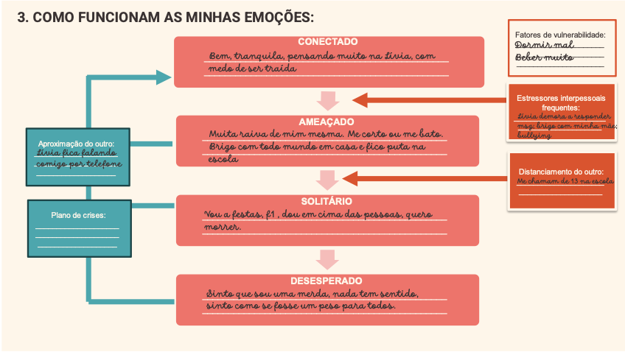
Guia do Residente
Resident handbook for the ADRE service — orientation, framework, and case-formulation tools
The handbook
Interpersonal dynamics
Cover page. Orientation, team structure, treatment phases, admission criteria, and rotation calendar for incoming residents.
Interpersonal dynamics of BPD — adapted from the GPM manual. Shared framework for every resident on the service.
GPM-A • 20 / 33
Notes:
[~45 s, Croci] One concrete implementation tool we built: the Guia do Residente — the resident handbook for ADRE. Two pieces shown here. The front cover and orientation section — team structure, treatment phases, admission criteria, and the rotation calendar for incoming residents. And a section on the interpersonal dynamics of BPD, adapted from the GPM manual, which gives every resident the same case-formulation language from day one. Simple thing, but it lowers onboarding time and anchors fidelity.

Slide 21
Research protocol — assessment timeline
Instruments by domain across the 6- to 12-month GPM-A program
M0
Admission
M3
M6
M8
M10
M12
Discharge
Weekly · Monthly (M1–M9) · Quarterly checkpoints (M3, M6, M8) · Full battery at M0 & M10
Diagnoses and personality functioning
CI-BPD · LPFS-BF 2.0
Repeated assessment
BSL-23 Main & Supplement (monthly) · BPFS-C (quarterly) · ZAN-BPD lability 1-item (weekly)
Trauma / eating / medical
QUESI-CTQ · EAT-26 · Medical Questionnaire (admission & discharge)
Emotional regulation / dissociation
DERS-16 · DES
General psychopathology
CBCL/6-18
Suicidality / self-harm
C-SSRS · DSHI-9 · RSS
SES / functioning / quality of life
SES · WSAS (monthly) · CGI · YQOL-R
Therapist-patient / alliance / stigma
GPM Principles · WAI-SR · GPM-AS · Attitudes toward BPD · Acceptability/Feasibility
GPM-A • 21 / 33
Notes:
[~75 s, Croci] Quick sketch of the research protocol by domain. Diagnoses and personality functioning at admission and discharge — CI-BPD and LPFS-BF 2.0. Repeated assessment of BPD severity — BSL-23 monthly, BPFS-C quarterly, and the ZAN-BPD lability 1-item weekly. Emotional regulation and dissociation — DERS-16 and DES. Suicidality and self-harm — C-SSRS, DSHI-9, and RSS. Trauma, eating, and medical screening — QUESI-CTQ, EAT-26, and a medical questionnaire at admission and discharge. General psychopathology — CBCL/6-18. SES, functioning, and quality of life — SES, WSAS monthly, CGI, and YQOL-R. Therapist–patient and alliance — GPM Principles, WAI-SR, GPM-AS, Attitudes toward BPD, and Acceptability/Feasibility. Full battery at M0 and M10; quarterly checkpoints at M3, M6, and M8.

Slide 22

Challenges
Paulista Avenue · São Paulo
Notes:
[~5 s, Brañas] Handoff — I'll walk through the challenges we faced implementing this program.

Slide 23
C1
Diagnosis & differential diagnosis
BPD is heterogeneous — patients present with distinct symptom profiles
Patient A
Patient B
Patient C
Interpersonal hypersensitivity
Anger issues
ADHD symptoms
Interpersonal hypersensitivity
NSSI
Suicide threats
Interpersonal hypersensitivity
Dissociative & paranoid symptoms
Withdrawal
Substance use
Trainees often default to depression, ADHD, or PTSD — ongoing discussion of BPD psychopathology and the literature is a day-to-day necessity.
GPM-A • 23 / 33
Notes:
[~60 s, Brañas] Before the specific challenges, one point about heterogeneity. Same diagnosis — BPD — three very different presentations. Patient A: interpersonal hypersensitivity, anger, ADHD-like symptoms. Patient B: interpersonal hypersensitivity, NSSI, suicide threats. Patient C: interpersonal hypersensitivity, dissociation, paranoid symptoms, withdrawal, substance use. The common thread is interpersonal hypersensitivity — everything else varies. Trainees see the variation and default to whichever comorbid label is loudest — and miss the BPD formulation underneath. So a constant part of supervision is re-anchoring the formulation to BPD and discussing the literature. This is a day-to-day necessity, not a one-time teaching point.

Slide 24
Comorbid disorders & other conditions
How the ADRE caseload extends beyond BPD — and how we respond
Gender Dysphoria
Eating Disorders
Collaboration with a specialized clinic at USP
GPM-A for Eating Disorders + collaboration with a specialized clinic at USP
Autism
cPTSD
GPM-A+B
DBT-PE and DBT-PTSD elements
Dudas & Cheney, 2025
Choi-Kain, 2021
ADHD
Mood Disorders
Frequently the stopping-point diagnosis. Residents read impulsivity and mood reactivity as ADHD alone and miss the BPD formulation. Our response: routine CI-BPD screening + formulation supervision.
Depressive and bipolar-spectrum features can mask BPD. Our response: we teach residents to hold both diagnoses when criteria are met, rather than default to the mood label.
BPD at USP in the last 10 years — from undiagnosed and ignored to a recognized institutional and national priority.
GPM-A • 24 / 33
Notes:
[~75 s, Brañas] Adolescent BPD at ADRE is almost never alone. Six comorbidity patterns we navigate. Gender dysphoria — we collaborate with a specialized USP clinic. Eating disorders — GPM-A for Eating Disorders plus a USP partner clinic. Autism — GPM-A plus the B-for-autism adaptation from Dudas and Cheney, 2025. Complex PTSD — elements from DBT-PE and DBT-PTSD, following Choi-Kain, 2021. ADHD is frequently the stopping-point diagnosis — residents read impulsivity and mood reactivity as ADHD and miss the BPD formulation; our response is routine CI-BPD screening plus formulation supervision. Mood disorders — depressive and bipolar-spectrum features can mask BPD, and we teach residents to hold both diagnoses when criteria are met, rather than default to the mood label. The take-home for this slide: at USP in the last ten years, BPD has gone from undiagnosed and ignored to recognized as an institutional and national priority. That's a big shift.

Slide 25
C2
Keeping GPM-A on the rails
Two simultaneous drifts — residents and supervisors
Residents learning GPM + clinical fundamentals at once
Learning psychiatric interview, formulation, and risk assessment at the same time they learn the model.
Framework drift — two directions
GPM is eclectic — the principles are what matter, not the purity. Drift happens in two directions: some supervisors lean too passive (underusing structure, activity, accountability); others narrow onto crisis planning, skills, and suicidality.
Root cause: most supervisors also work in private practice with other models, which shapes what they bring into supervision.
Our response: GPM-AS scoring + framework-specific teaching
Weekly case supervision with the GPM-AS adherence scale used routinely
GPM-framework teaching in parallel to general-psychiatry training.
Diagnostic drift
Some residents prefer ADHD or PTSD labels and reframe any trauma history as PTSD.
Our response: routine CI-BPD + formulation supervision, reinforcing that BPD can coexist with ADHD/PTSD rather than be replaced by them.
GPM-A • 25 / 33
Unruh & Gunderson, 2016
Notes:
[~90 s, Brañas] Our first challenge is fidelity, and three drifts pull on it. One — residents are learning GPM and clinical fundamentals at once: they're picking up the psychiatric interview, formulation, and risk assessment at the same time they learn the model. Two — framework drift happens in two directions. GPM is eclectic, so as long as the principles are honored it's fine, but some supervisors lean too passive-psychodynamic, underusing structure, activity, accountability; others narrow onto DBT-style crisis planning, skills, and suicidality. Root cause: most supervisors also work in private practice with other models, and those models leak into supervision. Three — diagnostic drift: some residents prefer ADHD or PTSD labels and reframe any trauma history as PTSD; our response there is routine CI-BPD plus formulation supervision, reinforcing that BPD can coexist with ADHD or PTSD rather than be replaced by them. Our systemic response across all three: the GPM-AS adherence scale used routinely in weekly supervision, and GPM-framework teaching kept separate from general-psychiatry training so it can't quietly blend in.

Slide 26
C3
The waiting-room problem
From a contagion hot-spot to a structured group intervention
Long commutes, unpredictable arrivals
Many adolescents and their parents travel hours by public transit and arrive well before their appointments — leaving patients gathered together in the same waiting room.
Serious peer contagion incidents
Covert NSSI behaviors went undetected — on one occasion adolescents shared shaving blades in the waiting room. Substance exchange also occurred, and one adolescent developed a significant MDMA intoxication requiring emergency department transfer.
Our response: the Waiting-Room Group
A semi-structured group held by two clinicians (a psychiatrist and a psychiatric nurse) while adolescents wait for their resident appointment, alternating with group art-therapy sessions. In parallel, parents attend family interventions such as Family Connections.
GPM-A • 26 / 33
Notes:
[~90 s, Brañas] Third challenge — and one we didn't expect. Our patients and their families travel hours by public transit to reach the clinic, and arrival times are unpredictable, so high-acuity adolescents end up gathered together in the same waiting room well before their appointments. Two serious peer-contagion incidents pushed us to act: on one occasion adolescents shared shaving blades for self-cutting, and on another a patient developed a significant MDMA intoxication after a substance exchange in the waiting room and required an emergency-department transfer. Our response was the Waiting-Room Group — a semi-structured group held by a psychiatrist and a psychiatric nurse while adolescents wait, alternating with art-therapy sessions; in parallel, parents attend Family Connections.

Slide 27
C4
Nation-wide dissemination
ADRE graduates move into services where GPM is unknown — we built materials, publications, and events to seed them
Materials
Publications
National Events
• GPM Manual translated to Portuguese
• Harvard Medical School online course
• Psychoeducation videos — multi-site
• Original publications — PT, ES, EN
• Book chapters on BPD / GPM
• Free podcast episodes for clinicians
• Brazilian Psychiatric Association Annual Meeting
• Brain, Emotions and Behavior Congress
• Workshops at partner universities and services
GPM-A • 27 / 33
Notes:
[~60 s, Brañas] The dissemination strategy runs on three tracks. Materials: we translated the GPM manual to Portuguese, built a Harvard Medical School online course, and produced psychoeducation videos with our multi-site partners. Publications: original work in Portuguese, Spanish, and English, book chapters, podcast episodes. Events: Brazilian Psychiatric Association annual meeting, the Brain, Emotions and Behavior Congress, and workshops at partner universities.

Slide 28





Implementation partnerships & next frontier
ADRE-trained clinicians seeding GPM programs — and pushing beyond clinicians to leadership
CESUPA → GPM-A
FAMERP → GPM
Périgueux → GPM-A
Belém, Brazil
São José do Rio Preto, Brazil
Centre Hospitalier Périgueux, France
Yasmin Nascimento, MD
Silvana Costa, MD
Larissa Fares, MD
Bruno Soleman, MD
Vinicius Freitas, MD
Next frontier — leadership-level work: hospital directors, residency coordinators, and the health ministry.
BPD Awareness Day: ongoing project in the Brazilian Senate.
GPM-A • 28 / 33
Notes:
[~75 s, Brañas] Three implementation partnerships where ADRE-trained clinicians have seeded new GPM programs. CESUPA in Belém — Yasmin Nascimento and Silvana Costa launched a new GPM-A clinic. FAMERP in São José do Rio Preto — Larissa Fares and Bruno Soleman started a new GPM clinic. Centre Hospitalier Périgueux in France — Vinicius Freitas is leading a new GPM-A clinic there. The residency lever working outward. The next frontier is leadership-level work — hospital directors, residency coordinators, the health ministry — not just clinicians. Concrete example: an ongoing BPD Awareness Day project in the Brazilian Senate.

Slide 29
Residency training is the implementation lever
“
While the burden posed by BPD rivals that associated with other major mental illnesses, the prevailing disposition of psychiatrists remains
characterized by misinformation, stigma, aversive attitudes, and insufficient familiarity with effective generalist treatments.
Residency training programs are well positioned to better equip the next generation of psychiatrists.
— Unruh & Gunderson, 2016
GPM-A • 29 / 33
Notes:
[~60 s, Brañas] Unruh and Gunderson put this better than we can. The burden of BPD rivals other major mental illnesses, but psychiatrists still carry misinformation, stigma, aversive attitudes, and insufficient familiarity with generalist treatments. Residency programs are where that changes — they are well positioned to equip the next generation. That's the lever we're using.

Slide 30
ADRE as a training ground
Evidence that the residency lever works
TOP 2
2024 Prize for Excellence in Teaching
Awarded by the 5th-year medical students and
the Department of Psychiatry at USP
to the ADRE directors
out of 35 rotation options
for 8 consecutive years
Ranked 1st or 2nd every year among PGY-3 psychiatry residents at USP.
GPM-A • 30 / 33
Notes:
[~75 s, Brañas] Two markers that the residency lever works. First — of 35 rotation options for psychiatry residents at USP, ADRE has been ranked 1st or 2nd every year among PGY-3 residents for eight consecutive years. Second — the 2024 Prize for Excellence in Teaching, awarded by the 5th-year medical students and the Department of Psychiatry at USP to the ADRE directors. These aren’t vanity metrics; they mean residents are self-selecting into the program and then carrying GPM out into the system.

Slide 31
Future directions — GPM-NSSI
A generalist brief adaptation under development for NSSI in youth
Authors
Marcos S. Croci • Carole Kapp • Sebastien Urben • Natalia Saldanha • Lois W. Choi-Kain • Marcelo J.A. Brañas • Ueli Kramer
What we're building next
17.4% / 13.4% NSSI rates in adolescents / young adults — yet most don’t access DBT-A
Generalist adaptation deliverable in primary / non-specialist settings
Shared ingredients with effective self-harm care — formulation, diagnostic disclosure, psychoeducation, safety, family
NSSI-specific strategies — functional analysis, peer influence, motivation, mindful clinician stance
Stepped-care referral for complex or non-responding cases
GPM-A • 31 / 33
Notes:
[~75 s, Croci] One thing on the horizon — GPM-NSSI. NSSI rates run at 17.4% in adolescents and 13.4% in young adults in our data, and most of these young people will never reach DBT-A. So we are developing a generalist brief adaptation deliverable in primary and non-specialist settings. The shared ingredients with effective self-harm care stay — formulation, diagnostic disclosure, psychoeducation, safety, family. Layered on top, NSSI-specific strategies: functional analysis, working with peer influence, motivation, and a mindful clinician stance. Stepped-care referral is built in for complex or non-responding cases. Multi-site collaboration with Lausanne; co-authors include Carole Kapp, Sebastien Urben, Natalia Saldanha, Lois Choi-Kain, Marcelo Brañas, and Ueli Kramer.

Slide 32
Take-home
01
Adolescent BPD is a valid, treatable diagnosis
Under-diagnosed despite severity comparable to adult BPD.
02
Generalist-first where specialists are scarce
GPM-A is deliverable in a tertiary-care public system.
03
Local adaptations matter
FC + individualized parenting + structured waiting group solved real operational problems.
04
Residency is the implementation lever
Training the next cohort is how GPM spreads through a public system.
05
Systemic change requires institutional work
Leadership-level engagement + dissemination + international partnerships.
GPM-A • 32 / 33
Notes:
[~60 s, Brañas] Five take-homes. One: adolescent BPD is valid and treatable and still under-diagnosed. Two: generalist-first scales where specialists don't. Three: local adaptations — FC, individualized parenting, structured waiting group — solved real operational problems. Four: residency is the lever — that's how GPM actually moves through a public system. Five: systemic change takes institutional work, not just clinical work.

Slide 33

ADRE team
• Aline Cho
• João Cronemberger
• Matheus Costa
• Brisa Burgos
• Júlia Gerotto
• Natalia Saldanha
• Caroline Uchôa
• Juliana Souza
• Rejane Smith
• Derek Moreira
• Larissa Lima
• Roberta Yamamoto
• Eduardo Martinho
• Liana Tortato
• Thyale Brizolara
• Gabriella Cronemberger
• Marcelo Brañas
• Vanessa Tomasini
Tack!
• Isabella D'Andrea
• Marcos Croci
• Vinicius Freitas
• Jackeline Giusti
• Marina Peres
• Yasmin Nascimento
Thank you!
Major Collaborator
Contact
Lois W. Choi-Kain, MD, Med, DFAPA
Director, Gunderson Personality Disorders Institute,
McLean Hospital / Harvard Medical School
marcelo.branas@usp.br
marcos.croci@fm.usp.br
Karolinska Institutet · 5 May 2026
GPM for Latin America paper
Notes:
[~20 s, joint close] Thank you. Thanks to the ADRE team at USP, to our collaborators at the Gunderson Personality Disorders Institute, and to everyone who has helped this program grow. Happy to take questions.

