Slide 1
What is identity?
Values
• Roles
• Personality
• Continuity

Slide 2
What is i_en_ity?
Values
• Roles
• Personality
• Continuity

Slide 3
“[Like I’m] disappearing, that I’m no longer being.”
Patient descriptions of their identity
“[Like a] ghost masquerading as a human.”
“[Like] not being able to navigate who I am.”
Extracts: Black, Murray & Thornicroft (2014); Edwards (2015) and Jørgensen and Bøye (2022)

Slide 4
Self-Concept and Identity Measure Swedish validation
Rosie James, MSc
Doctoral Researcher
Originally developed by Kaufman et al. 2015
Validated in Swedish by James et al. 2023

Slide 5




Identity Disturbance in Personality Disorder
Central to personality disorders
Criterion A (Self-functioning) in DSM-5 AMPD
Essential feature in ICD-11
Heterogeneous presentations:
Externalizing (e.g., anger, unstable relationships)
Internalizing (e.g., identity problems, emptiness)
American Psychiatric Association (2013)
World Health Organization (2019/2021)

Slide 6

The Self-Concept and Identity Measure
Kaufman et al. (2015)
A dimensional measure of identity functioning
Consolidated identity
Disturbed identity
Lack of identity
Key features:
Captures both healthy and pathological identity
Includes novel dimension - Lack of Identity
“I always have a good sense of what is important to me”
Used in ongoing research, including:
Gender dysphoria
Identity development (BUP)
DBT treatment outcomes
“I imitate other people instead of being myself”
“I am broken”

Slide 7
How could SCIM be used clinically?
Clinical use
More detailed assessment of identity
Exploring identity in therapy
Identifying patients not responding to treatment
Lack of Identity (ongoing work):
Predicts onset of self-harm
Predicts recurrence (relapse)
Potential predictor of self-harm

Slide 8
Clinical takeaways
Identity disturbance is multidimensional
Identity-related difficulties may be more prominent in internalising presentations of PD
Identity can be assessed more systematically
Lack of Identity may signal risk for onset and recurrence of self-harm

Slide 9
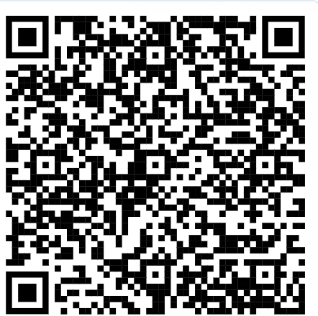
Swedish version of the Self-Concept and Identity Measure available via fbanken
Contact
Rosie James; Rose.James@med.lu.se
A thank you to: Sofie Westling (Supervisor); Magnus Nilsson (Supervisor)

Slide 10
References
American Psychiatric Association. (2013). Diagnostic and statistical manual of mental disorders: DSM-5 (5th ed.). Arlington, VA: American Psychiatric Publishing. https://doi.org/10.1176/appi.books.9780890425596
Black, G., Murray, J., & Thornicroft, G. (2014). Understanding the phenomenology of borderline personality disorder from the patient’s perspective. Journal of Mental Health, 23(2), 78–82. https://doi.org/10.3109/09638237.2013.869570
Edwards, D., Evans, N., Gillen, E., Longo, M., Pryjmachuk, S., Trainor, G., & Hannigan, B. (2015). What do we know about the risks for young people moving into, through and out of inpatient mental health care? Findings from an evidence synthesis. Child and Adolescent Psychiatry and Mental Health, 9, 55. https://doi.org/10.1186/s13034-015-0087-y
James, R., Daukantaité, D., & Nilsson, M. (2023). A validation of the Swedish Self-Concept and Identity Measure (SCIM) and its association with mental health problems. Heliyon, 9(7), e18151. https://doi.org/10.1016/j.heliyon.2023.e18151
Jørgensen, C. R., & Bøye, R. (2022). How does it feel to have a disturbed identity? The phenomenology of identity diffusion in patients with borderline personality disorder: A qualitative study. Journal of Personality Disorders, 36(1), 40–69. https://doi.org/10.1521/pedi_2021_35_526
Kaufman, E. A., Cundiff, J. M., & Crowell, S. E. (2015). The development, factor structure, and validation of the Self-concept and Identity Measure (SCIM): A self-report assessment of clinical identity disturbance. Journal of Psychopathology and Behavioral Assessment, 37(1), 122–133. https://doi.org/10.1007/s10862-014-9441-2

