Slide 1


Towards a dimensional trigger-based approach of emotional dysregulation in patients meeting criteria for borderline personality disorder
Martin Blay, MD, MSc
Psychiatrist-psychotherapist
Head of the Personality Disorder Unit EPSYLIA, Lyon, France
PhD candidate in clinical research at Paris Saclay University
Svensk personlighetspsykiatrisk kongress 2026 – Karolinska Institute, Stockholm, Sweden – May 6-7Th 2026

Slide 2
Conflit of interest
None

Slide 3
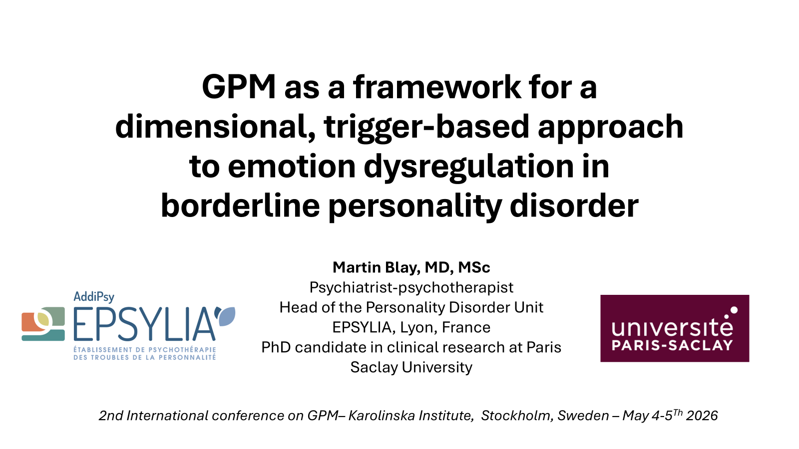
On Monday…

Slide 4
Our dear Mister X…

Slide 5
Mister X, 26
Referred for diagnostic evaluation for BPD
Medical history:
  BPD(reason for referral)
  ADHD (diagnosed at a specialized center)
  Adult ASD without ID (diagnosed at a specialized center)
  BD(diagnosed at a specialized center)
  Cannabis and alcohol use disorder
  Bulimia nervosa
  Complex PTSD (severe childhood trauma)
  Intimate partner violence
  DID (recently diagnosed in a private clinic)
Living situation: In an open relationship, no children. Lives with his girlfriend and another boyfriend in an apartment. Not working. Dropped out of high school due to mental health issues
Medication: XEROQUEL 600mg, TERCIAN 100mg, TEMESTA 2.5mg

Slide 6
Clinical picture
Multiple emotional outbursts throughout the day
  Self-harming and, at times, aggressive behaviors
  Multiple substance and food-related issues (substances and food)
  Anger outbursts
  Recurrent dissociative and paranoid symptoms
Major interpersonal difficulties
  Hypersensitivity to rejection and fear of abandonment
  Difficulties with social cognition
Post-traumatic symptoms, including hypervigilance and, at times, significant flashbacks

Slide 7
How to treat ?
ASD Specialist: “ASD must be first”
BD Specialist: “BD must be stabilized first”
EMDR Therapist: “We must start by stabilizing the flashbacks”
Referring Physician: “Above all, BPD must be treated first”…
…
Patient: “I don’t understand any of this”

Slide 8
Introduction

Slide 9
Some definitions
Emotions : « Whole-body phenomena, that include changes in subjective experience, behaviors, and physiology, and that emerges in response to a specific object/situation perceived as relevant for oneself »
Emotion regulation can be defined as the way people attempt to influence this phenomenon, using different type of strategies
Emotional dysregulation: lots of conceptualizations
  DBT : emotional vulnerability and invalidation
  MBT : mentalizing deficits
  Others: process model of emotion regulation
Gross & Thompson, 2007; McRae & Gross, 2020; Gross, 2015

Slide 10
Emotional dysregulation and BPD
First categorical description of ED and its consequences in BPD
  At least 4/9 criteria: self-harm & suicide, affective lability, impulsive behaviors, anger…
  These symptoms are therefore often associated with BPD…
  … Even though we now know that it is a transdiagnostic construct
    Other PDs: NPD, OCPD, ASPD
    NDDs : ADHD, ASD
    (c)PTSD
    BD
This makes it hard to distinguish between these disorders,BPD, and true comorbid conditions, even more so given the high rates of comorbidity among these disorders
Carmassi et al., 2022; Sloan et al., 2017; Blay et al., 2024
Notes:
“Studies have reported a 37% prevalence rate of BPD in NPD patients, of 16.6% in OCPD patients, and of 21% in ASPD patients (26). Regarding bipolar disorder, empirical studies have found a 20% prevalence rate of BPD in patients with type II bipolar disorder (27). Regarding trauma, 25–30% of adults meeting criteria for either PTSD or BPD also meet criteria for the other disorder, and BPD is comorbid in 8-79% of cPTSD cases (23). Regarding neurodevelopmental disorders, prevalence rate of BPD is 27.2% in patients with adult ADHD (28) and between 0 and 10.6% in patients with ASD (29). “

Slide 11
Need for a dimensional approach
Categories are useful, particularly because they provide an overarching framework for understanding suffering that patients can often easily grasp…
  But they are also limited and lack strong support from the data, the latter indicating that these issues should be considered dimensionally
New dimensional approaches
  HiTOP (and its super-spectrum emotional dysfunction)
  ICD-11 & AMPD
  But : very little implementation in clinical practice, where the categorical approach remains the most widely used
Craddock & Mynors-Wallis, 2014; Haslam et al., 2012; Eaton et al., 2023; Watson et al., 2022

Slide 12
Consequences
The various conditions associated with ED can have very different psychopathological and interpersonal implications
Thus, it seems reductive to directly link ED to BPD, and it may even lead to potential important consequences
  Impaired therapeutic relationship due to lack of epistemic epistemic correspondence
  Missing key issues may lead to treatment drop-out/resistance (e.g., ASD, PN)
  Delays in prescribing medication and/or failure to prescribe medication (e.g., ADHD, BD)
Blay et al., 2023; Blay et al., 2024; Campbell et al., 2009; Richter et al., 2023; Bemmouna et al., 2022

Slide 13
Development of our trigger-based approach
To propose a simple, trans-diagnostic, and process-oriented model to assist clinicians in their daily practice, particularly those who do not specialize in the management of ED and who continue to rely on a categorical approach
Based on triggers (the specific factors that cause ED in each disorder) and interpersonal styles.
Why these two aspects?
  Because they are the most variable between patients
  Because they are the most likely to reflect underlying psychopathology, while the others (NSSI, impulsive behaviors, SA…) are much more behavioral in nature
But if we want to use triggers as differentiating factors, we need to understand how and why they may differentially develop
Blay et al., 2024

Slide 14
Developmental perspective

Slide 15
Emotions
Emotions cannot be reduced to physiological responses…
  Appear in a relevant situation, leading to an attention focus on the important aspects of that situation, an evaluation of those aspects in relation to one’s objectives and goals, and ultimately physiological and behavioral activation
… Thus, their regulation cannot be reduced to the ability to modulate this activation
  A dynamic set of extrinsic and intrinsic processes responsible for regulating, evaluating, and modifying the intensity and timing of emotional responses, which individuals use to achieve their goals while taking social expectations into account.
Barret et al., 1987; Thompson, 1994; Gross et al., 2015

Slide 16
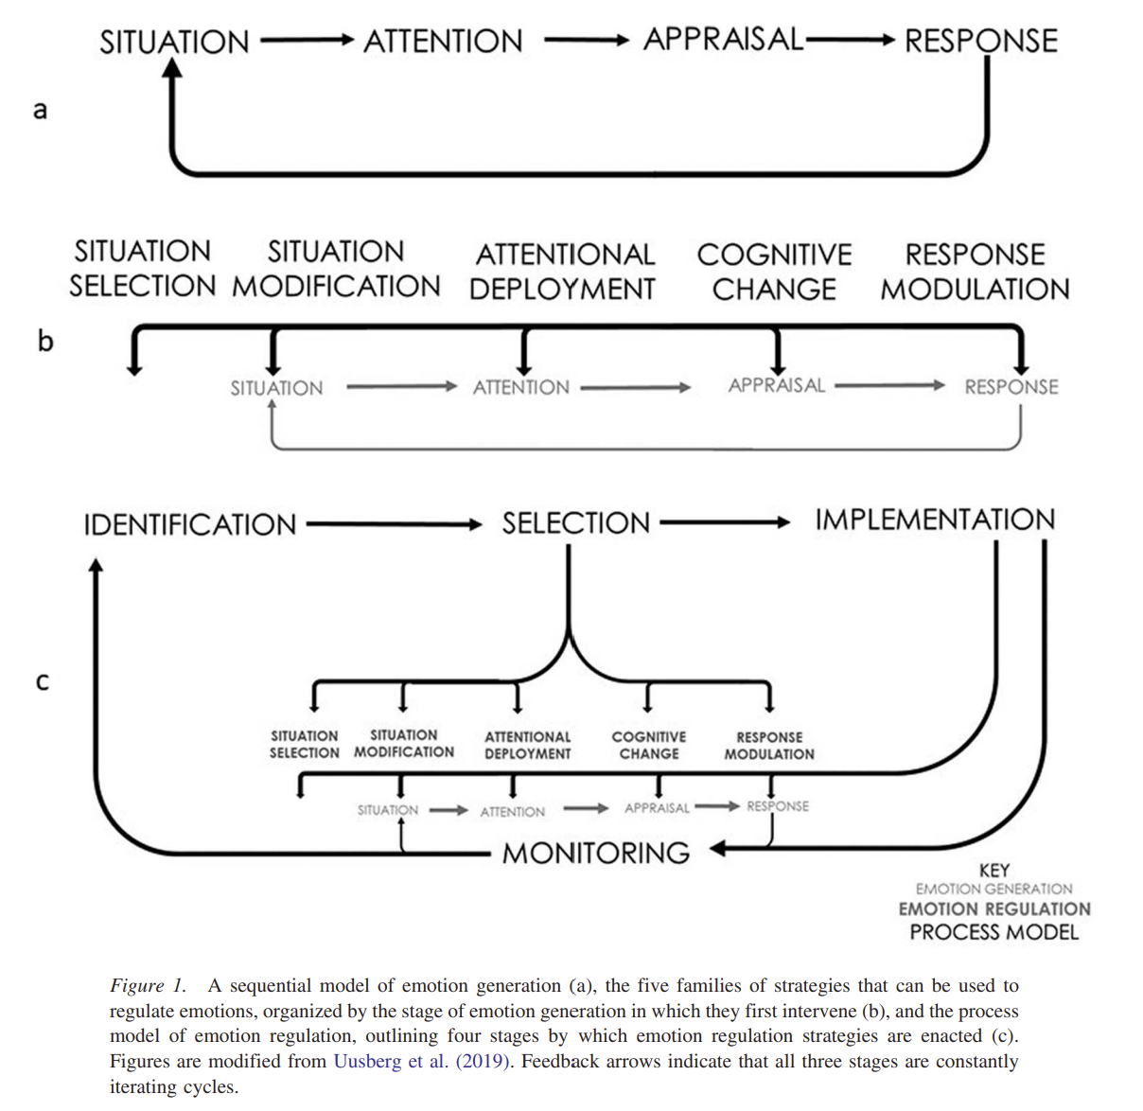
Process model of emotion regulation
McRae & Gross, 2020

Slide 17
Development of emotion regulation
A complex and ongoing process
  During the first few months, regulation is solely external
  Gradual acquisition of internal regulation
    Emergence of intrapsychic strategies: redirecting attention, cognitive reappraisal
    Flexibility: adapting strategies to the context, using multiple strategies
    Integration of social norms and well-being goals
  Of course, this is highly dependent on the type of environment in which the individual develops -> attachment
    Contingent, congruent, and marked parental mirroring
Emotional regulation becomes problematic when an individual’s ER patterns disrupt short- and/or long-term developmental goals
  Interference with the achievement of short- and/or long-term well-being goals
  Hinder developmental expectations regarding appropriate behavior
  Conflict with sociocultural norms regarding emotion-related communication and behavior.
McRae & Gross, 2020; Cole et al., 2019; Debbané, 2022; Blay et al., 2024

Slide 18
ED as a context-dependant construct
It therefore appears that DE should not be reduced to the presence of overly intense or prolonged negative emotions.
Degree of ED seems to depend more on the context in which emotions arise and on how the individual balances their well-being goals with the realities of their environment
While certain regulatory patterns and/or attachment styles may be adaptive in the immediate context, they can become maladaptive in the long term as the environment changes
  Ex : NPD, expressive suppression, et humiliation
Cole et al., 2019; 1994; Debbané, 2022; Blay et al., 2024; 2024

Slide 19
Why these specificities?
  Different biological and neurocognitive backgrounds
    Ex : ASD and difficulties in filtering relevant situations, ADHD and fluctuations in attention
  Different environment
    Ex : OCPD and over-controling, moralizing or compulsive environment

Slide 20
Evaluation

Slide 21
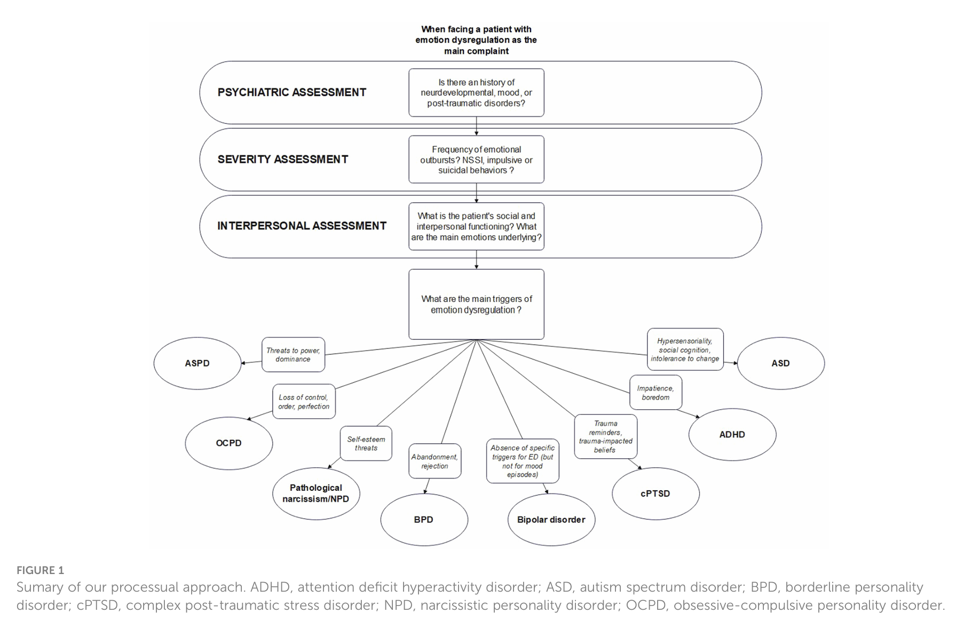

Slide 22
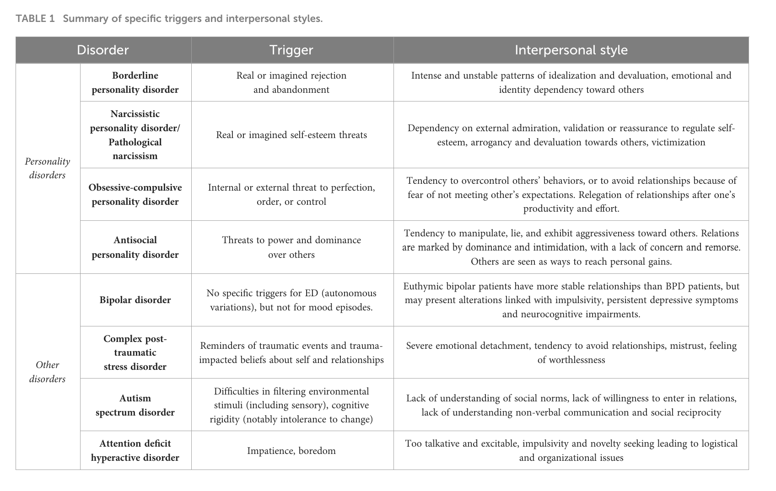

Slide 23
Applied to M. X
History : everything
Severity
  Emotional outbursts at least once a day, often several times a day, primarily involving anger
  Self-harming behaviors at least once a week (cutting arms and thighs, punching walls), multiple visits to the emergency room, 3 suicide attempts in the past year
  Rare but serious acts of aggression toward others (hitting his girlfriend and another friend, hitting his mother)
Interpersonal functioning
  No close friends, just a few acquaintances. Complex relationship with the mother; no relationship with the father; no siblings.
  Interest in peers varies but expresses desire to form more connections. Significant difficulty in understanding others’ perspectives.
  Conflictual relationship with a partner, linked to a major fear of abandonment.
  Underlying emotions: anger and fear
2 main triggers
  Fear of abandonment and rejection
  Traumatic reminders and cognitive disorsions (father’s violence and homeless period)

Slide 24
Treatment

Slide 25
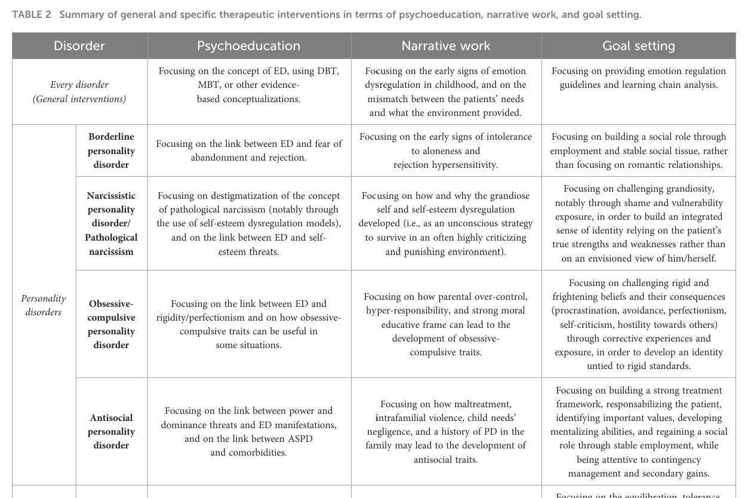
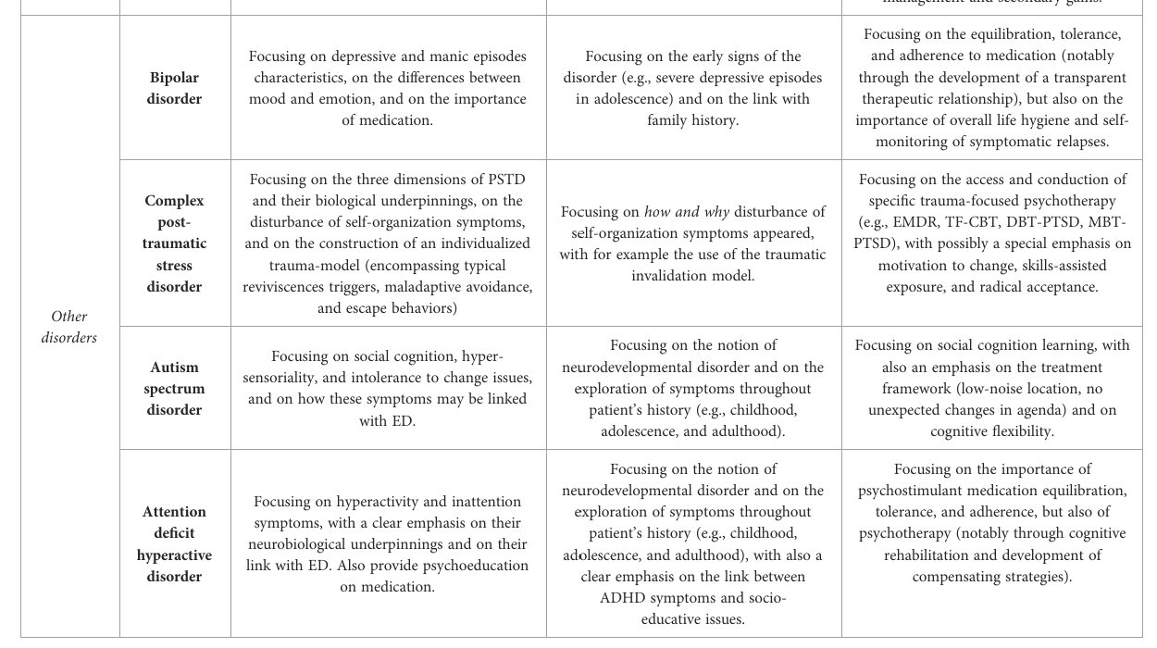

Slide 26
Applied to M. X
First and foremost:
  Discussing the reasons behind multiple diagnoses+++ and the importance of a multidimensional approach focused on what is causing the disability (i.e., ED)
  Emphasizing the therapeutic relationship and setting shared goals
Individual sessions = 2 therapists
  Individual GPM for:
    Managing emotional crises
    Narrative work
    Life outside of treatment, particularly social fabric
  EMDR for flashbacks
Group = 3 groups
  Psychoeducation on BPD
  Psychoeducation on trauma
  DBT for skills training

Slide 27
After 1 year
Good therapeutic relationship, good investment in care
Significant reduction in emotional outbursts and self- and other-directed aggressive behaviors
Improvement in flashbacks
No further mention of DID, ASD, or BD
Stabilization of the romantic relationship, improvement in the relationship with the mother
But… Continued substance use. Still significant social isolation. No employment.
To be continued…

Slide 28
Thank you for your attention.
Martin.blay5@gmail.com
Martin Blay, MD, MSc
Psychiatrist-psychotherapist
Head of the Personality Disorder Unit EPSYLIA, Lyon, France
PhD candidate in clinical research at Paris Saclay University

