Slide 1



Borderline Personality Disorder Collaborative
GPM Complex
Laura Cooke-O’connor | Advanced Clinician Coordinator
Cathy McLeod Everitt | Service Development Manager

Slide 2
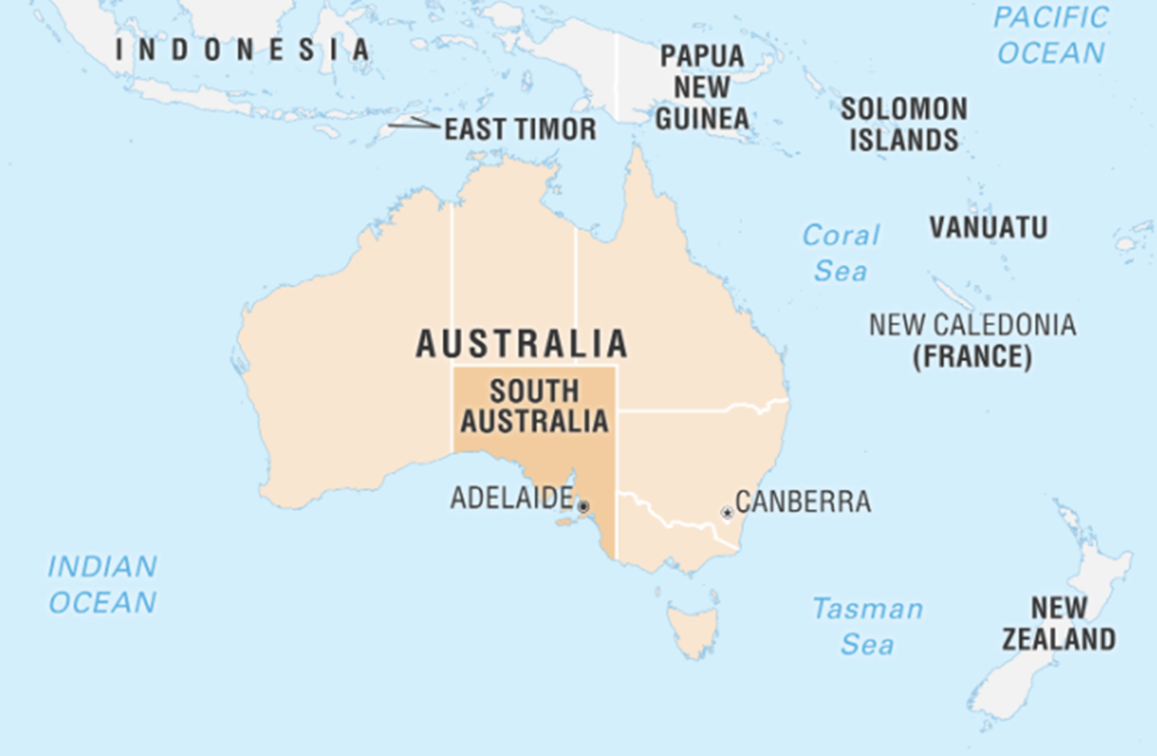
South Australia
Subtitle
Heading
  Population: 2m
  Area 983, 482km²
  BPD pop est:
  17,700 – 70,800
  BPD Co: 12.5
  Clinical FTE
  dot points
  dot points
Notes:
Kaurna Country – Adelaide – acknowledging the Kaurna people as the traditional owners of the land which is commonly referred to as Adelaide and is where BPD Co is located.
As a statewide service we service the entire state.
For context size wise – Sweden would fit into SA 2.2times
Population - SA 2m and Sweden 10.7m, 5.5 times larger population
Of the 2m of the 1.5m live in Adelaide - population spread across our regional and remote area is very small – this presents a challenge when trying to deliver mental health services and particularly evidence-based services for people living with BPD across the state
Our presentation today outline how as a service we have adapted GPM for complexity, we will outline our services foundation which has facilitated the implementation of GPM-Complex across the state and we will share a case study which provides an example of a systems approach to complex care utilising the GPM-complex framework.
Our service, a government funded specialist MHS was initially conceptualised as a centre of excellence; however, this model risks undermining our core philosophy of strengthening the entire system— leading instead to the development of a Collaborative, a systems approach that invests in local excellence, supports clinicians to build confidence and capability to deliver care within their own settings, increasing access to tx care where people live.
Given the high prevalence of the disorder between 17,000 and 72,000 – and in acknowledgement of resource constrained public mental health service our MoC it to implement a…

Slide 3
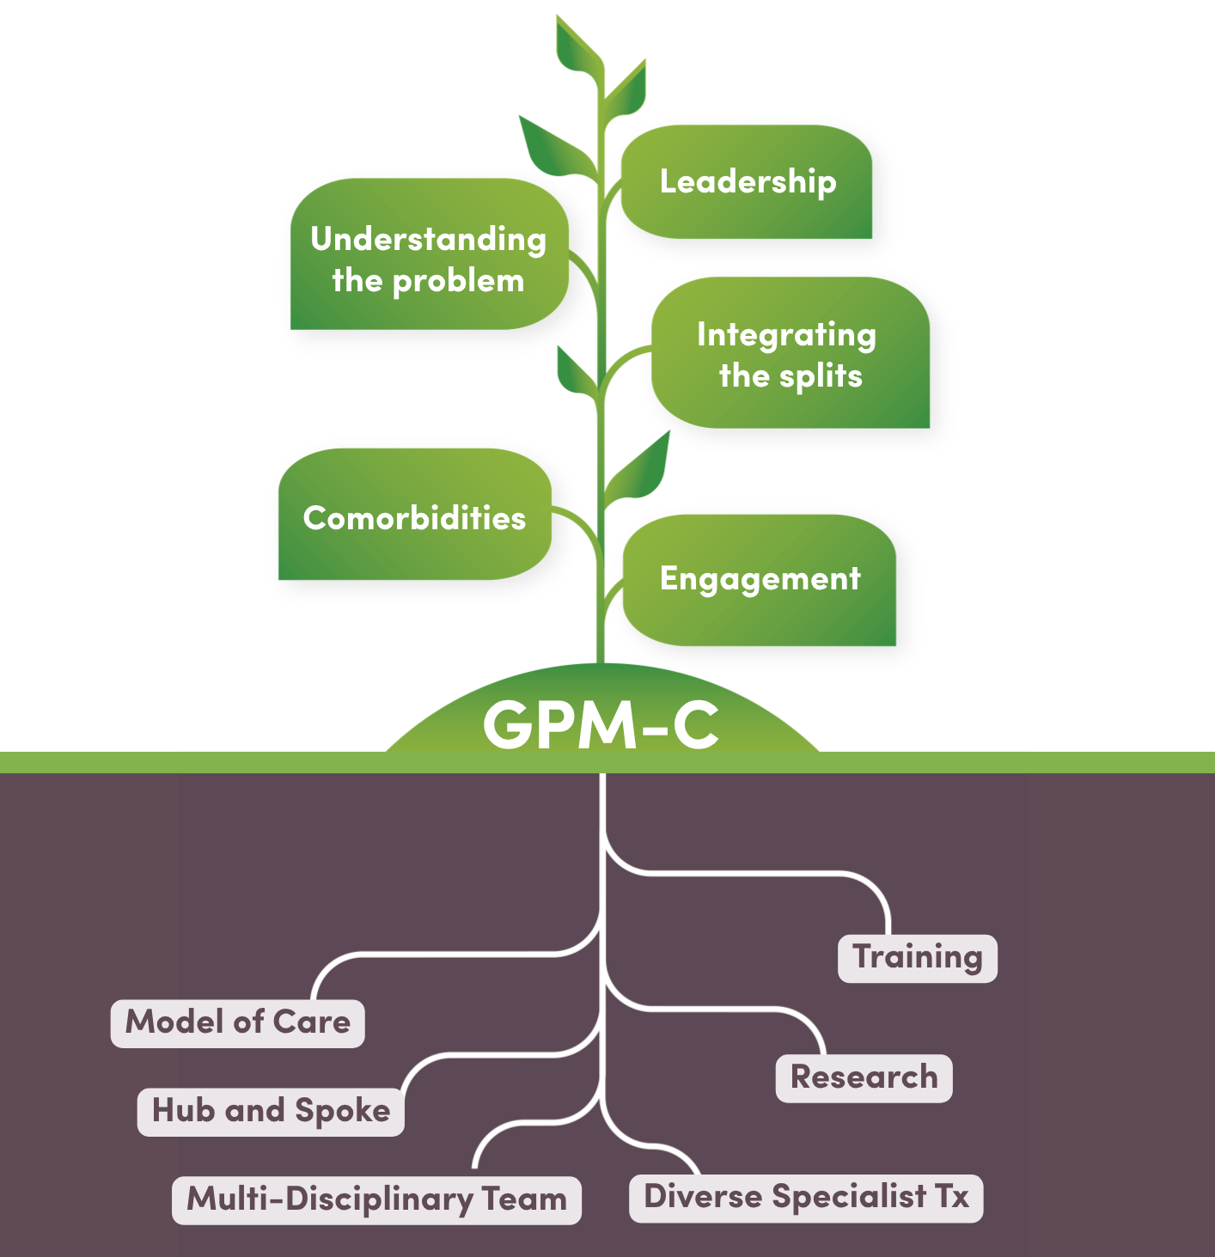
Stepped Care Model
Stepped Model of Care
Brief intervention
Intermediate interventions
Intensive Interventions
Notes:
Brief interventions a 4 session post crisis intervention – developed by PA.
And a 6 session GPM intervention for young people is being implemented in a regional location, using the Interpersonal Coherence Model as a hypothesis generator.
Intermediate interventions – consisting of short-term (10-12week) individual or group interventions have been developed and delivered
- Implementation of 10 session GPM Clinic at BPD Co.
Provides an opportunity for our team of clinicians, Psychiatry Registrars and students to develop experiencing in delivering GPM
Intensive Inventions – this includes the specialist EB tx (you are all familiar with)
- more specifically what we are here to talk about today is GPM for complexity where people are presenting with a level of complexity that prohibits engagement with the specialist EB tx.

Slide 4
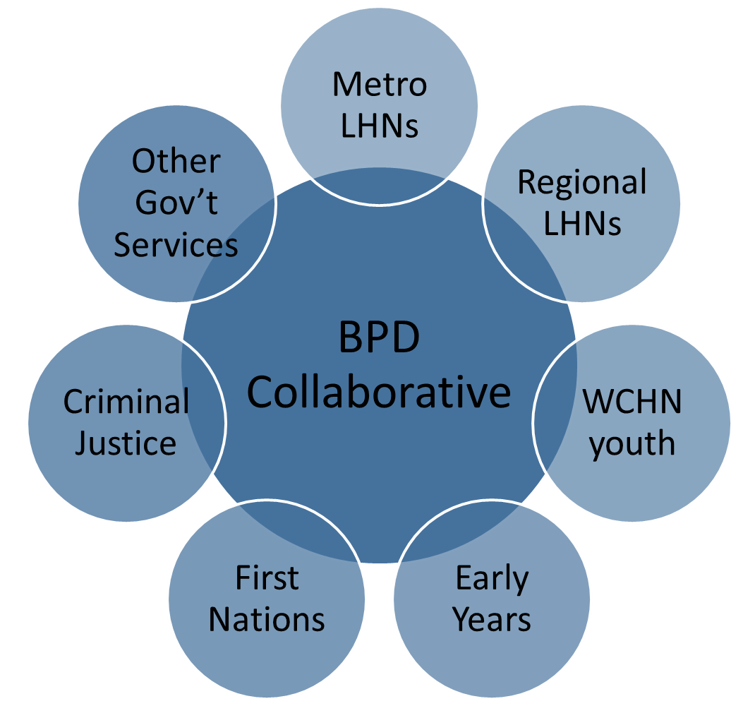
Hub and Spoke
Subtitle
Heading
  dot points
  dot points
Notes:
Our service model is facilitated by a hub and spoke model
Hub - BPD Co is situated as the hub our team of clinician and project workers are based and outreach to the
Spokes – the services across the state, including local MHS based in the communities across the state.

Slide 5
Implementation Process
Subtitle
Leadership
Tailored to the environment
Team Engagement
Training
Supervision & mentoring
Evaluation
Heading
  dot points
  dot points
Notes:
Guided by implementation science BPD Co have utilised a structure process to support system wide engagement and implementation of the model of care.
- Leadership – engagement with Exec and then local leadership in the health networks
Understanding the local environment – through regular meetings and having our hub clinicians on the ground in the local teams, their role is to get to know the local environment
Clinician establish relationships with the teams, these connections have facilitated opportunities to promote the GPM framework
With exec/leadership endorsement and willingness from the team clinicians
GPM and GPM-A training has been provided across the state, accompanied by
Post training support – supervision and mentoring has been key to supporting integration to practice.
Having a dedicated Research team has helped embed evaluation mechanisms into all elements of our service
Which is fed back in partnership meetings to support continuous quality improvements

Slide 6


Overall principles
Good Psychiatric Management
McLean Gunderson
Personality Disorders Institute

Slide 7
Six Principles of GPM
1
Seek to understand, develop treatment plans and procedures around key problems
Challenge passivity, avoidance, silences, diversions in pt & team
You are the “container” (cautious, thoughtful, “hold” projections)
BE ACTIVE (responsive, curious), not reactive
Notes:
The curiosity and now knowing stance can assist when attempting to understand the client’s difficulties. You want to show you are interested in understanding their experience and to develop treatment plans around the key problems (not diagnosis). This provides a framework for the treatment.
Remember the treating team can also step up and step down depending on what is happening. Ie some team members may be in a threatened state.
Challenge passivity, encourage agency but make sure your expectations re agency are in line with where the client is at.
Remember that what is happening in the client can also be happening in the team.
Container. No matter what is going on try not to be reactive. Hold your position in a kind but firm way.
Name it rather than try to solve it.
Be realistic. Will prevent your own frustration and minimise unhelpful expectations of client.

Slide 8
Six Principles of GPM
1 - BE ACTIVE
2
SUPPORT: VALIDATION
Seeing the everyone’s description as legitimate and understandable
NOT the same as agreeing — requires “not knowing” or being right or wrong
Orients team and patient to collaboratively “make sense” as a first step of good general care
SUPPORT via listening, interest, selective validation
Notes:
Seeing everyone’s description as legitimate and understandable can be applied to treatment team as well.
Need to be able to contain clinician’s anxiety.

Slide 9
Six Principles of GPM
1 - BE ACTIVE
2 - support
3
FOCUS ON LIFE SITUATIONS, relationships and vocation
WORK BEFORE THERAPY!
Therapeutic protocols that require a robust alliance and reflective process requires a frame to be safe and effective
Understand what is working or not and why
Constructive collaboration is required as a basic first step
Notes:
Last updated on:

Slide 10
Six Principles of GPM
1 - BE ACTIVE
2 - support
3 - focus on life situations
4
Selective disclosure - e.g., “you scared me,” “that would make me angry”
Stay in your lane (i.e, roles and goals) competence build confidence and trust
THERAPY RELATIONSHIP IS REAL (DYADIC) AND PROFESSIONAL
Notes:
Development of the therapeutic relationship is very important. You want the relationship to be a new experience for the client, one they can internalise.
Focus on being real/authentic.
Tell them what you think ie share what is on your mind when it is in the best interests of the client.

Slide 11
Six Principles of GPM
1 - BE ACTIVE
2 - support
3 - focus on life situations
4 - real, DYADIC, PROFESSIONAL
5
CHANGE IS EXPECTED
A lack of improvement is indicative of treatment failure
Re-evaluate whether or not team is reaching goals
Notes:
Is the treatment you are providing helpful?

Slide 12
Six Principles of GPM
1 - BE ACTIVE
2 - support
3 - focus on life situations
4 - real, DYADIC, PROFESSIONAL
5 - change is expected
6
ACCOUNTABILITY - pts as active collaborators in treatment, in assuming control of their life
“You are the primary agent of change”
Notes:
Last updated on:

Slide 13
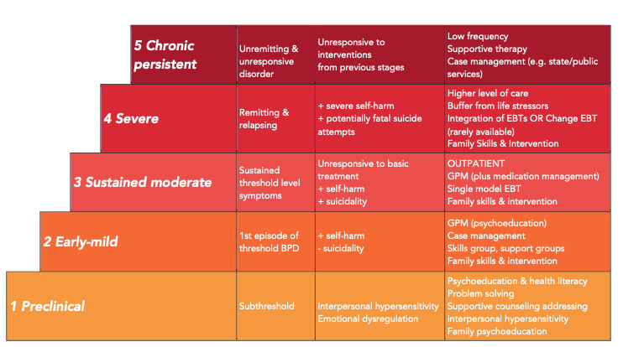
Stepped care MODEL
Severity Definition Potential Interventions
McLean Gunderson
Adapted for Applications of GPM for BPD: A Practical Guide (APPI 2019) by Gabrielle Ilagan and Lois Choi-Kain from Choi-Kain LW, Albert EB, Gunderson JG: Evidence-based treatments for borderline personality disorder: implementation, integration, and stepped care. Harvard Review of Psychiatry 24(5):342-56, 2016.
Personality Disorders Institute
Notes:
Within our system many of our client’s are not ready for the intensive evidence based therapies – unable to commit to 1-2x per week therapy, requiring ED and bedded services which interferes with attendance at appts, not motivated or do not have the capacity to engage in therapy.
Some will require a period of GPM until ready to engage in therapy, others will require a systems approach indefinitely.
Define Complexity
3 or more comorbid psychiatric diagnoses
Frequent acute service utilisation
Presenting with high risk
Requiring support from multiple systems (Mental Health, Acute hospital/ED, First Responders, NDIS)

Slide 14
GPM – COMPLEX CARE
Build a strong structure/home in which to provide good enough care
Understand the problem
Integrate splits: There is no magic bullet
Manage co-morbidities and co-occurring problems
Enlist patients’ involvement – especially in treatment decisions
Notes:
Often multiple teams/organisations involved. Important to focus on building alliances and a strong structure around the client. A responsive, predictable structure can provide containment of the client.
When there are more than 3 diagnoses ie complex, then it is important to define the problem that will be the focus of treatment. This needs to be decided upon collaboratively with the client.
Identify splits when they occur and focus on integrating the different experiences and views. There is no magic bullet ie no easy treatment path. Idealised solutions vs disappointing reality.
Identify comorbidities and address eg ID, ASD. They are likely to influence treatment plan.
Important to enlist the patient’s involvement. This in itself will assist in building agency, which is often a core problem for the patient.

Slide 15
Interpersonal hypersensitivity
Core formulation
McLean Gunderson
Personality Disorders Institute
Notes:
****

Slide 16
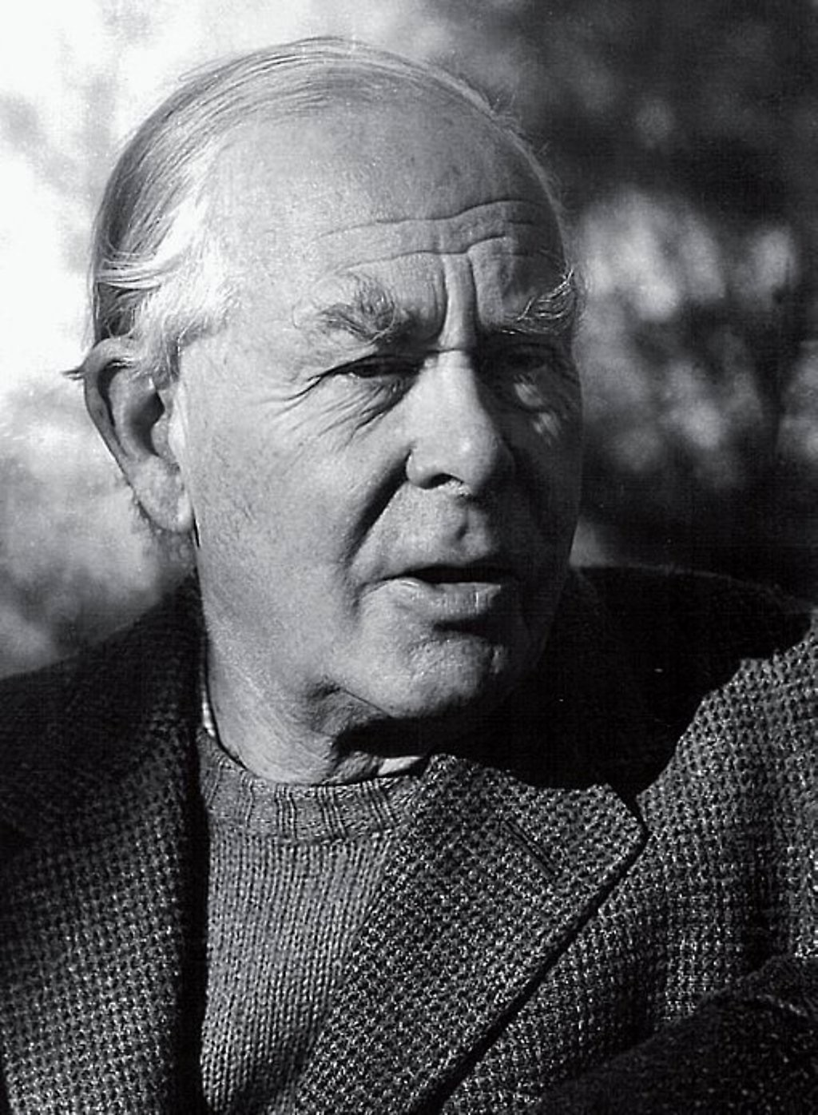
Childhood attachment determines
later capacity to make affectional bonds as well as a whole range of adult dysfunctions… [including] personality disorders.
John Bowlby

Slide 17








Organizing strategies of disorganized attachment
Disorganized attachment functions to organize unpredictable caregivers
Dissociation
Controlling
Entertaining
Caregiving
Hostility
Aim to improve bids and quality of support, more relating, less reacting
Notes:
Infants that have a disorganized attachment (ie their attachment bids are disorganized) have a parent that behaves in a frightened/frightening or hostile/helpless way. They are faced with a dilemma. The person who is frightening is also the person who they approach for comfort and security. They have an approach/avoidance dilemma.
They do not have a way or organizing their attachment system. Avoidant/dismissive and ambivalent/preoccupied are organized ways of meeting attachment needs.
Infants who are disorganized develop strategies to make caregivers more predictable. They are controlling strategies – controlling punitive and controlling caregiving (child cares for parent so parent can be more functional). These controlling behaviours’ preserve a connection but in a way that destabilises it.
A disorganized patient gives out confusing mixed messages. This tends to disorganize the attachment figure (eg clinicians/treating team). The patient is acting out of fear or anger. The patient uses their hostility or caregiving to get a consistent response. The treatment team’s job is to get more consistent and organized, predictable.
When faced with hostility aim is to not react to their behaviour (except to ensure safety). Focus on emotions. Think first – what is going on? Slow them down so they can think about what they want and need.
Problem is disorganized attachment bids are destructive of relationships. Attachment system needs to become organized.
Aim to assist the client to develop prosocial bids to get their needs met. And support teams to be more relational and less reactive.

Slide 18

Connected
Controlling-caregiving
Safety-seeking
Real or perceived threat to self or relationship with other
Threatened
Controlling-punitive
Stress- Fight or flight
Withdrawal of others
Alone
Unanchored from reality
GPM’s Interpersonal Hypersensitivity
(IHS) Model
Unilateral intervention by others to rescue, confront, or contain (interventions, hospitalizations, police)
Despair
Worthless, hopeless
Suicidal, lost
McLean Gunderson
Personality Disorders Institute

Slide 19
Connected
To idealized over-valued object
Dependent, insecure, vigilant
Stress-sensitive
Damaging effects of stress is mediated by 5 domains:
Interpretation
Predictability
Outlets for frustration
Social support
Control
Interpretation
Predictability
Active Coping
Prosocial behavior
Interpretation
Predictability
Active Coping
Prosocial behavior
Threatened
Limitations that disappoint ideal
Fight or flight
Control
Outlets for Frustration
Alone
Unanchored from reality
(i.e., consequences, intentions of others, and experience)
Control
Outlets for Frustration
GPM’s Stress Sensitivity Model
Despair
Worthless, hopeless
Suicidal, lost
McLean Gunderson
Personality Disorders Institute
Notes:
Mitigating domains ie domains you can work on:
How a person interprets a stressful situation- whether it’s perceived as a threat or a challenge-can significantly alter its impact
Predictability - a lack of predictability can heighten the feeling of being overwhelmed
Outlets for frustration – find healthy ways to release or express frustration can mitigate the build up of stress ie sports.
Social support - having a strong support network assists
Control - a sense of control over one’s life and the ability to influence outcomes is a powerful protective factor against the detrimental effects of stress.
Lean in:
Appraise and accept reality
Work out disagreements or misunderstandings
Manage limitations within self and others, integrate splits.
Discuss disappointments/disillusionment
Define boundaries around oneself and others
Consider self-reliance as an antidote to hypersensitivity to others

Slide 20

GPM: THERAPEUTIC APPROACH
Education is essential — especially for the social safety network
Non-specific factors are central — reliability, listening, concern
Relational issues are central — attachment, trust
Situational changes can be essential — advise, assist
Pragmatism — every patient is different; forego theory if it isn’t working; if not now, wait

Slide 21
COMORBIDITY
McLean Gunderson
Personality Disorders Institute

Slide 22
ADDRESS COMORBIDITY
Consideration
Examples
Prioritize comorbidity when
Comorbidity precludes involvement or active learning
Mania, adhd, ASD
Cognitive limitation, anorexia
Prioritize bpd when
Comorbidity is unlikely
to remit or likelier to recur unless bpd is in remission
depression, anxiety, social phobia, remitted bipolar disorder, substance use, bulimia
Stabilize bpd before addressing comorbidity to
Increase patient’s ability to tolerate exposure THERAPY
Panic disorder, ptsd, ocd
Adapted from mercer & links, 2019
Notes:
Last updated on: 03.13.19

Slide 23

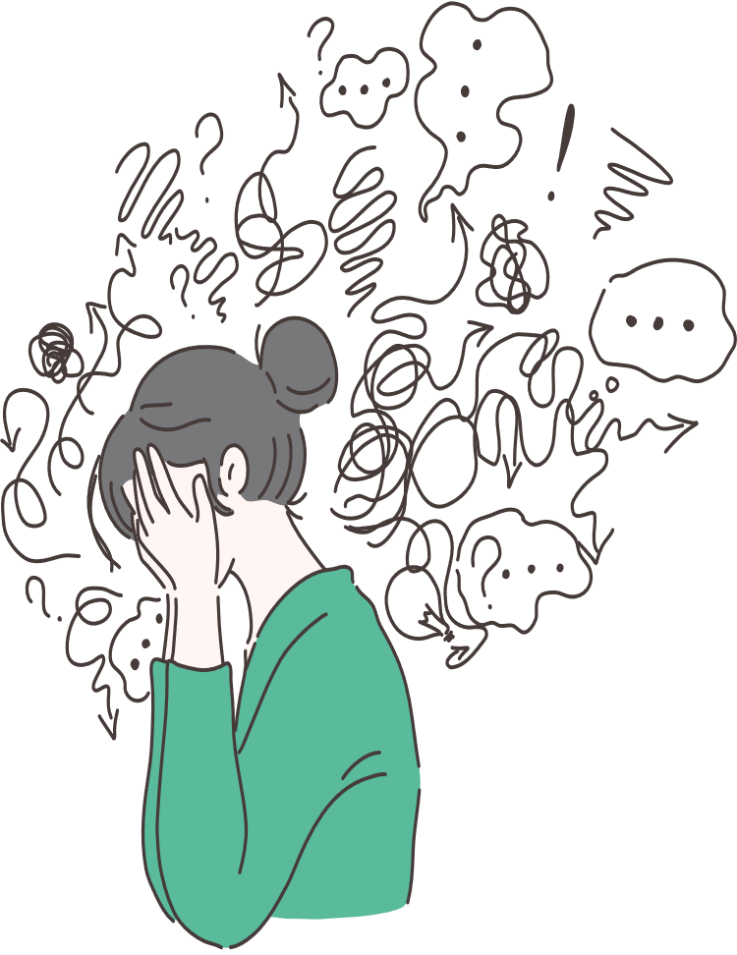
Case Study

Slide 24
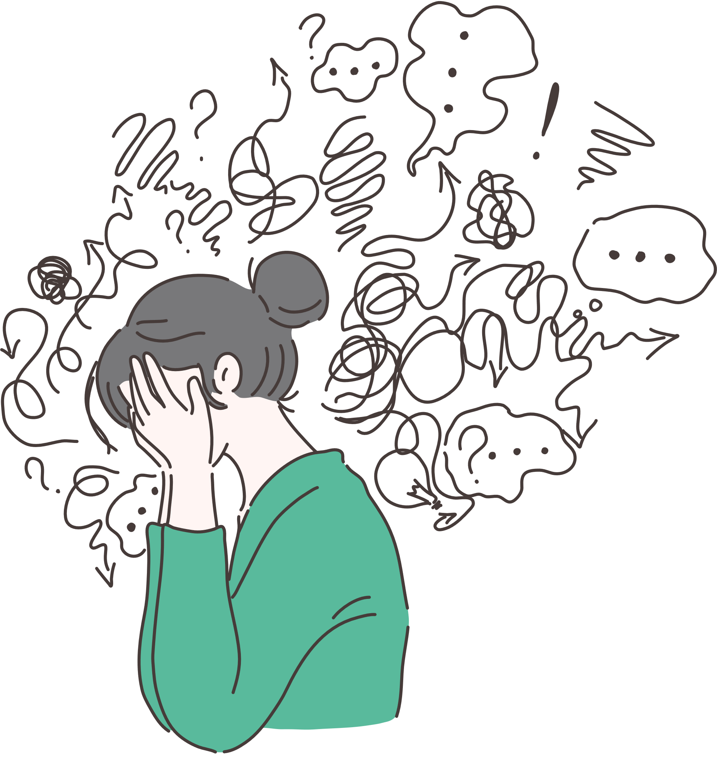
Background
Name: Karen
Details: 45 female
Background: mother of two children, unable to manage parenting responsibilities, not living in the family home at time of referral.
Frequent presentations to hospital and dysregulated behaviour including aggression, absconding, threats of suicide and threats of violence to mental health and front line staff. In the year of referral over 200 days in bedded services
Family expressing high levels of dissatisfaction of mental health services, including complaints to the minister.

Slide 25
The Community Mental Health Team were struggling to know how to manage the degree of dysregulation and acting out behaviours. The team were experiencing high levels of burn out and hostile counter transference.
Referred to BPD Co for diagnostic clarification and recommendations of support for staff.

Slide 26
Leadership:
Review of existing service plan
Support services to define roles and responsibilities
Understand/Define the problem:
10-session GPM Assessment
Predominant Dependent Personality Disorder (DPD), as well as BPD with avoidant features
Integrate Splits:
Explore team’s counter-transference
Tension between short-term containment and safety interventions and reinforcement of ongoing dependency and avoidance
Address Comorbidities:
Adapted ICM for DPD (overvalued reliance on external supports)

Slide 27
Engagement:
Strong resonance with ICM
Engagement in working toward simple, practical goals
System-level engagement with therapeutic formulation, with development of management plan to facilitate consistency of response across services
Engagement of family: family meetings, psychoeducation, supporting recalibration of expectations and readjustment of responses
Progress:
Karen has returned to living in the family home and is increasing her participation in family and parenting activities and responsibilities
Significant reduction in hospital days over the past year (172 → 7)
Increased capacity to tolerate direct conversations about the core problem and impacts of reassurance-seeking and containment-seeking behaviours

Slide 28
GPM teamwork
McLean Gunderson
Personality Disorders Institute

Slide 29
Rules for partnership in split treatment
Establish Clear roles
Especially for managing crises (safety), taking phone calls from family members
Talk to each other
Insist on the need and right to talk to each other, except for personally sensitive disclosures that don’t involve safety or that jeopardize the treatment
Don’t accept the other treater’s vilification
examine, don’t protect or agree with the other treater’s vilification
encourage voicing complaints directly to treater
Urge that complaints be voiced to the other treater (this is a corrective experience!)
McLean Gunderson
Personality Disorders Institute
Notes:
Last updated on:

Slide 30
Connected
Stress-sensitive
Efforts to cope/engage
Dependent, insecure, vigilant
Protective, concerned, preoccupied, anxious. Overinvolved, inadequate boundaries, adherence to plan
Threatened
Limitations that disappoint ideal
Fight or flight (Self-harm)
Criticized, blamed, unappreciated, angry
Rejecting, punitive, rigid adherence to plan.
Alone
Unanchored from reality
(i.e., consequences, intentions of others, and experience)
Despair
Worthless, hopeless
Suicidal, lost
Relational dynamics
COUNTERTRANSFERENCE
McLean Gunderson
Personality Disorders Institute

Slide 31

Connected
Stress-sensitive
Efforts to cope/engage
Dependent, insecure, vigilant
Foster self-reliance, self-assertion, expressing need for help prosocially.
Accept uncertainty and lack of control.
Threatened
Limitations that disappoint ideal
Fight or flight (Self-harm)
Foster effective disagreement and expression of anger. Understand reasons for self-harm and what is wanted.
Alone
Unanchored from reality
(i.e., consequences, intentions of others, and experience)
Despair
Worthless, hopeless
Suicidal, lost
Relational dynamics
COUNTERTRANSFERENCE
McLean Gunderson
Personality Disorders Institute

Slide 32
Connected
Stress-sensitive
Efforts to cope/engage
Dependent, insecure, vigilant
Protective, concerned, preoccupied, anxious. Overinvolved, inadequate boundaries, adherence to plan
Listen nondefensively
Understand wish/want
Express disappointments
Acknowledge reality
Accept lack of control
Threatened
Limitations that disappoint ideal
Fight or flight (Self-harm)
Criticized, blamed, unappreciated, angry
Rejecting, punitive, rigid adherence to plan
Alone
Unanchored from reality
(i.e., consequences, intentions of others, and experience)
Despair
Worthless, hopeless
Suicidal, lost
Relational dynamics
COUNTERTRANSFERENCE
McLean Gunderson
Personality Disorders Institute
Notes:
Still can’t quite follow the slide.
The list on the left is what you want to happen to minimise polarising responses. 3rd and 5th are what you want the patient to do ie express their disappointment, accept lack of control.
Clinician should aim to listen nondefensively understand the wish/want and acknowledge reality.
Clinician needs to be able to bear the patient’s disappointment.

Slide 33
Team provides interpersonal coherence
Listen to all views
Understand all the team member’s dilemmas and formulation of problems
Talk to each other
Insist on the need and right to talk to each other
Educate & support
Validate difficulty of staff involved, foster compassion for each other, decrease blame
encourage voicing complaints directly to treater
Urge that complaints be voiced to the other treater (this is a corrective experience!)
McLean Gunderson
Personality Disorders Institute
Notes:
Last updated on:

Slide 34
Case Study

Slide 35
Background
Name: Lenora
Details: 16 yo female
Background: Complex developmental trauma, disrupted attachment. Removed from parents as a child, placed in care with extended family, returned to live with mother as an adolescent. Removed from mother’s care by Child Protection Services, placed in residential care with multiple placement changes and breakdowns.
Maladaptive care seeking behaviour, frequent presentations to Hospital following self harm and presenting with physical issues to elicit admissions.

Slide 36
Symptoms: emotional dysregulation, auditory/visual hallucinations, suicidal/homicidal ideation, severe self-harm ingestion of glass, razor blades, starvation.
Diagnosis : BPD, C-PTSD, FND, ADHD, ID.
Services involved: Department of Child Protection, Residential Care, CAMHS Guardianship team, Children's Hospital ED, Adolescent inpatient ward, Hospital surgical team, Hospital consultation/liaison team, SAAS, SAPOL, Education, NDIS

Slide 37
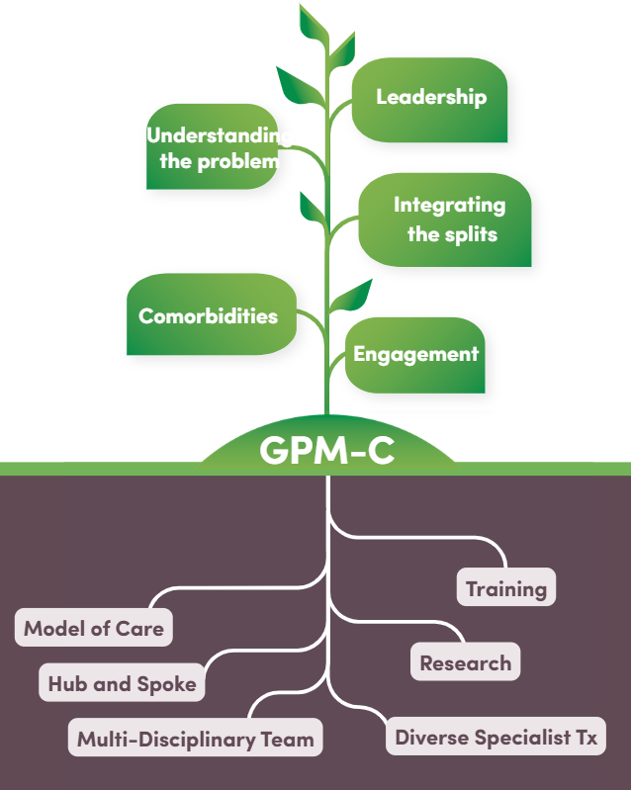
BPD Co receive referral from DCP for Psychiatry review current management of patient due to high risk and systems overload
Initial meeting with DCP Executive and CAMHS Psychiatrist followed by meeting with Residential Care and staff management
Development of training to be provided to DCP staff and residential care incorporating GPM-A framework /family Guidelines.
Meeting with Minister for Child Protection and Chief Executive of Child Protection.
Meeting with Director of Residential Care to understand problems staff are facing.
Delivery of training and reflective practice sessions post training to DCP/Residential care staff.
Notes:
LEADERSHIP
BPD Co meeting with the care teams – engaging their leadership – listening
UNDERSTANDING THE PROBLEM
There is conflict between treaters (mental health services) and carers (DCP/resi care)
Staff are overwhelmed and scared of Lenora dying, they have been told they need to keep Lenora alive
Staff have put in complaints about the children’s hospital as they believe Lenora should be admitted long term to keep her safe
Hospital staff tell Lenora she needs to go back home where they can keep her safe
Staff feel criticised by SAPOL and SAAS who tell them they need to keep her safe
The treating team is getting bigger and bigger, more services involved
INTEGRATING THE SPLITS
Acknowledge the commitment from the treatment team and carer team with providing opportunities to improve Lenora’s mental health. Validating their ability to maintain understanding and compassion under such anxiety provoking situations. You are pragmatic in stating that the mental health difficulties are severe and complex and there is high risk of death by suicide or misadventure.
COMORBIDITIES
You provide a clear outline of how she meets criteria for BPD and discuss the co-occurring co morbidities, acknowledging the symptomatic overlap of BPD and C-PTSD and high burden of symptoms. You also outline the role of EBT for BPD.
Collaboratively you engage key stakeholders with understanding the problem, identify the splits, define roles and enlist engagement at a systems level to embrace a GPM-A framework to assist in managing the difficulties and offer support needed to do this, including training and reflective practice to residential care staff.
ENGAGEMENT

Slide 38
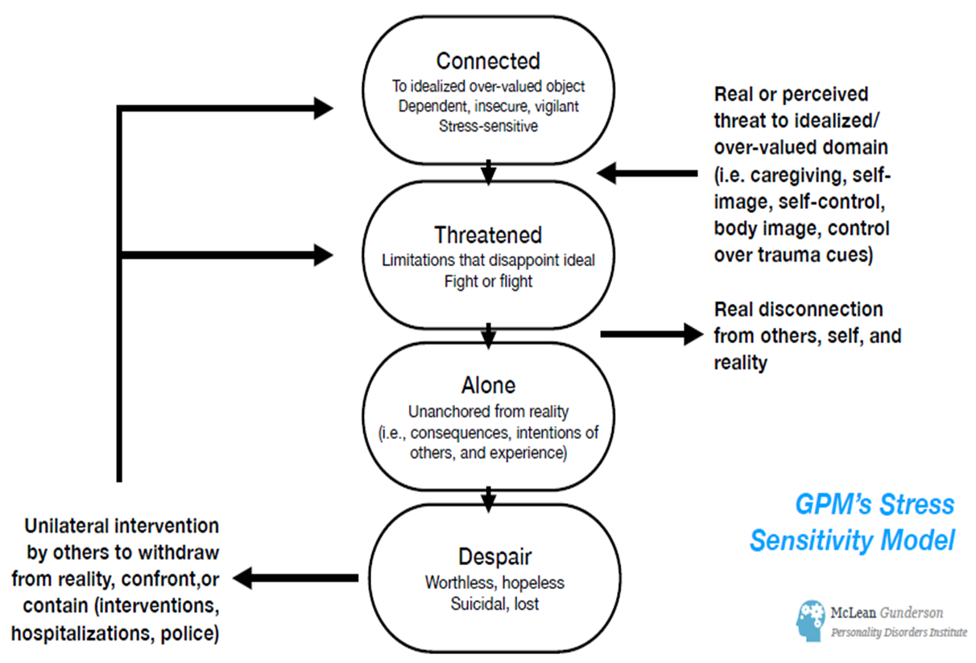
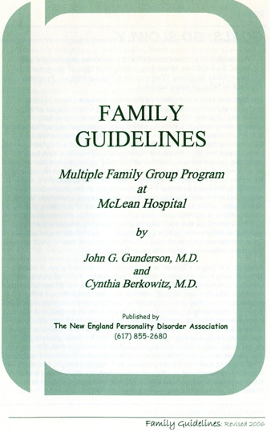
Training the residential care team
Introducing the ICM as a framework to help increase understanding
Exploring how to lean in, to be active and not reactive, get them more organised, responsive, predictable, consistent and reliable
Using the principles in the family guidelines to:
    Providing care not treatment
    Keeping things cool and calm
    Change is difficult and fraught with fears – go slowly with setting goals
    Being realistic about expectations
    Not getting defensive in the face of accusations and criticisms
    Listening to negative feelings
    Paying attention to self destructive acts
    Acting in concert with one another
Notes:
You develop a workshop on caring for young people with personality difficulties in residential care settings.
Starting with basic information about personality development, how difficulties develop and the stress this causes.
Using the ICM as a framework to help them understand common personality vulnerabilities, to better understand what might be going on for the young people they are working with.
Get them thinking about how to lean in, to be active and not reactive, to keep things cool and calm, to get them more organised in a responsive, predictable, consistent and reliable way.

Slide 39

You meet with the CAMHS clinician to provide GPM-A coaching until they can attend training and supervision:
They let you know the GPM-A approach is helping them manage their own anxiety from the daily emails coming in from multiple services, which cause them to step out of their lane.
They are focusing on their job of maintaining a therapeutic alliance with Lenora and instilling hope and encouraging agency

Slide 40
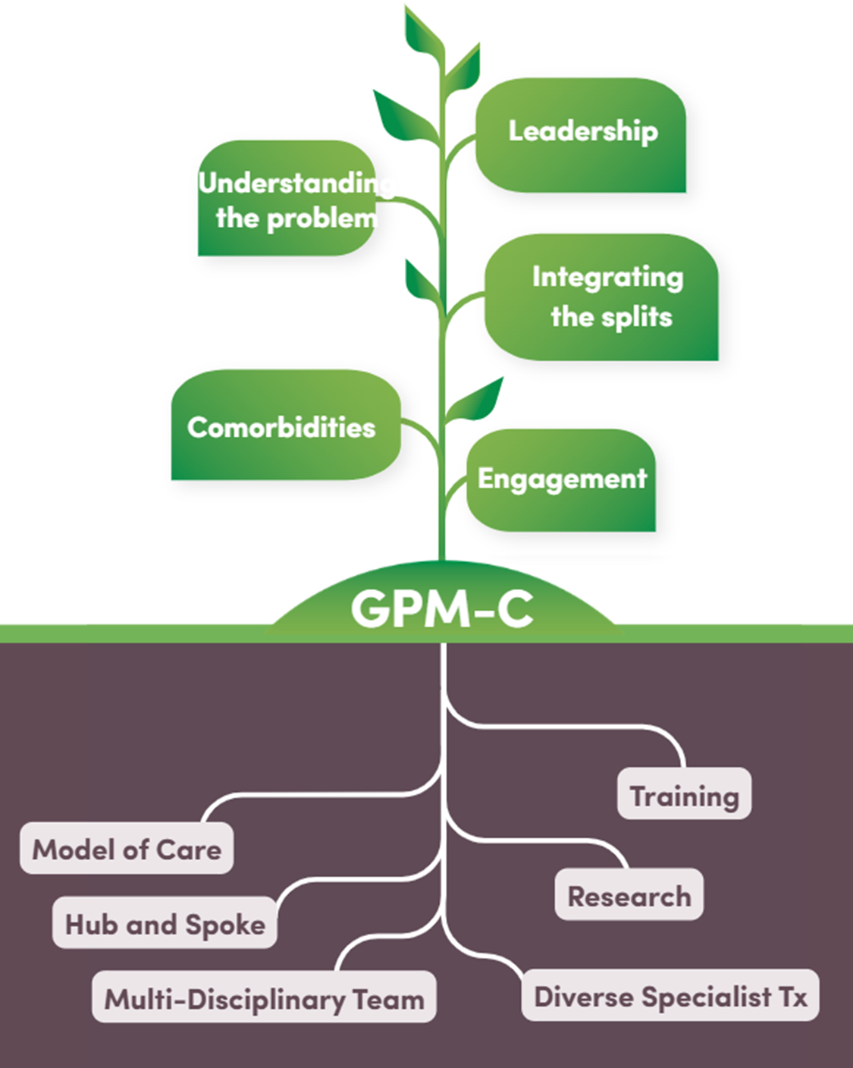
Meet with CAMHS Exec promote value of GPM -A. Approval for clinicians to attend training and GPM-A supervision
Build relationships with clinicians working in metro/regional youth mental health services
Promotion of GPM-A Handbook and Training.
Adolescent clinicians working in metro/regional MHS attend GPM-A Complex Workshop with Lois Choi-Kain 2024.
Delivery of GPM-A training to CAMHS clinicians.
Delivery of supervision/coaching sessions post training.
Development of GPM-A Network, meets monthly.GPM-A Supervision with Lois Choi Kain 2025 with clinicians working with diversity of presentations.
Notes:
Impact for CAMHS of training and

Slide 41

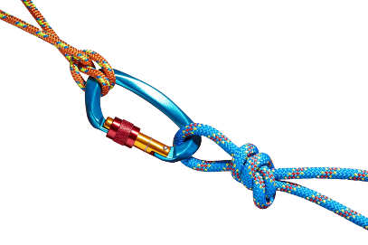
BPD Co receive referral from DCP for Clinical Lead to review current management of patient due to high risk and systems overload
Initial meeting with DCP Executive and CAMHS Psychiatrist followed by meeting with Residential Care and staff management
Meet with CAMHS Exec promote value of GPM -A. Approval for clinicians to attend training and GPM-A supervision
Build relationships with clinicians working in metro/regional youth mental health services
Promotion of GPM-A Handbook and Training.
Development of training to be provided to DCP staff and residential care incorporating GPM-A framework /family Guidelines.
Meeting with Minister for Child Protection and Chief Executive of Child Protection.
Meeting with Director of Residential Care to understand problems staff are facing.
Adolescent clinicians working in metro/regional MHS attend GPM-A Complex Workshop with Lois Choi-Kain 2024.
Delivery of GPM-A training to CAMHS clinicians.
Delivery of supervision/coaching sessions post training.
Delivery of training and reflective practice sessions post training to DCP/Residential care staff.
Development of GPM-A Network, meets monthly.
GPM-A Supervision with Lois Choi Kain 2025 with clinicians working with diversity of presentations.

Slide 42
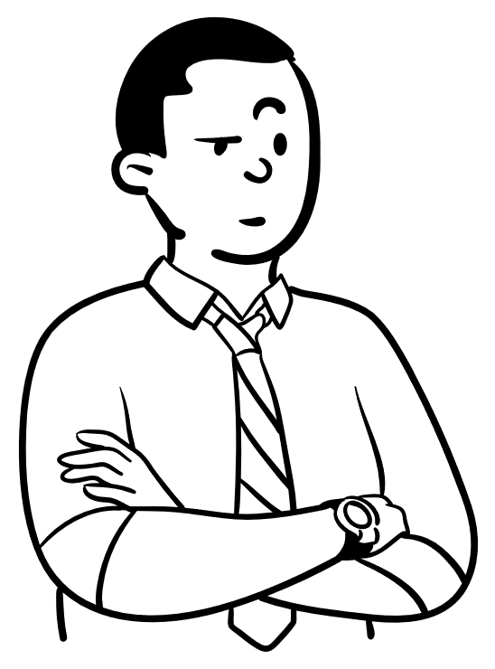


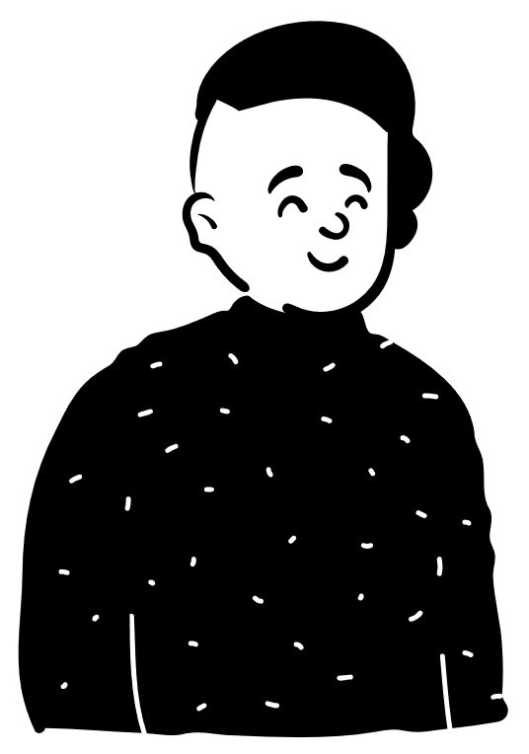
Reflective practice session to the residential care team and supervision to CAMHS clinicians.
Feedback from staff attending the reflective practice highlights how they feel:
They are being more of a detective about what is going on for the young person
They have a greater understanding of connection rather than attention
Senior staff have been modelling leaning in to new staff
They are staying in their lane
Getting back to basics and keeping it simple
Communication is improving, providing consistent messaging as a team and initiating restorative conversations when things have cooled down
Less punitive in approach
Learning how to hold risk that it is all helping with the next young person they will be working with
Notes:
They acknowledge they were not responding to Lenora but to the system needs/demands. That the high number of staff/services involved was more about how many people it takes for staff to feel safe.
They tell you they have reduced the care team and have noticed there is less interpersonal noise in the house.
They are focusing on spending time with Lenora, instead of filling in forms about her, taking the time to lean in and have noticed their tolerance for risk has increased. That there is a focus on consistent behaviour from staff.

Slide 43
GPM framework for BPD Co Team
Organising framework
    Shared language
    Scaffolding and integration of diverse specialist therapies
    Clarity of roles and responsibilities
    Realistic expectations
    Helps manage countertransference
    Maintaining limits

Slide 44
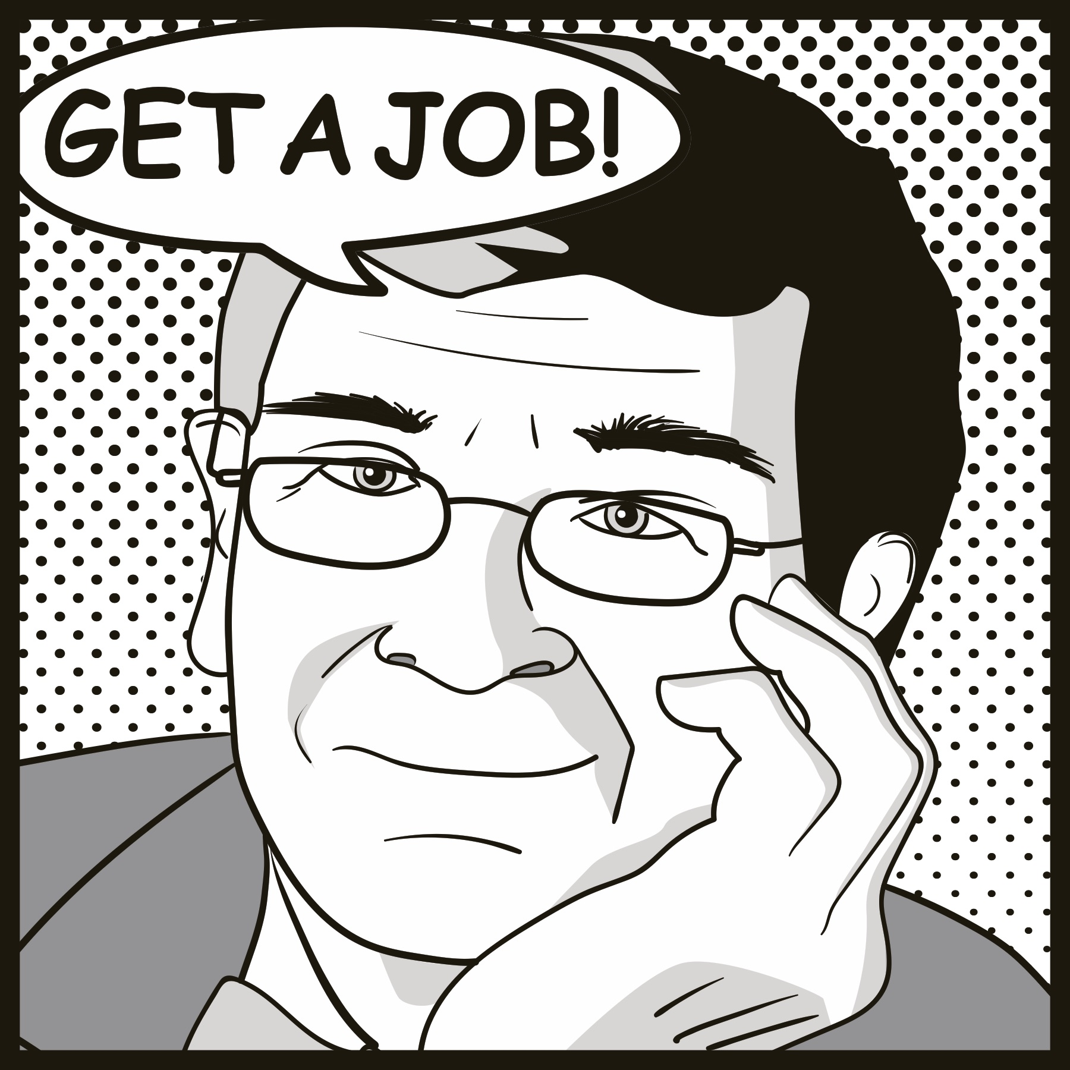

thank you
HEALTH.BPDSERVICE@SA.GOV.AU
GUNDERSONPDI@partners.org
McLean Gunderson
Personality Disorders Institute

