Slide 1
ICD-11 klassificering av Personlighetssyndrom Så förändras utredningsprocessen
Flavio Di Leone
Sektionschef | Överläkare | Doktorand
Mottagning för Personlighetssyndrom, Sahlgrenska Universitetssjukhus
Sahlgrenska Akademin, Göteborgs Universitet

Slide 2
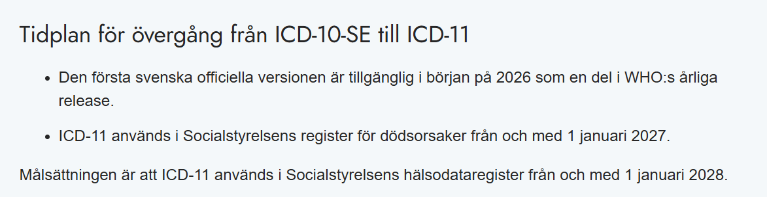
Varför talar vi om ICD-11?
The changes in the new classification of Personality Disorders are likely the most significant shift in psychiatric diagnostics in the past forty years:
“The advent of the ICD-11 PD classification involves major changes for health care workers, researchers, administrators, and service providers as well as patients and families involved.”
Bo Bach et al., 2022

Slide 3
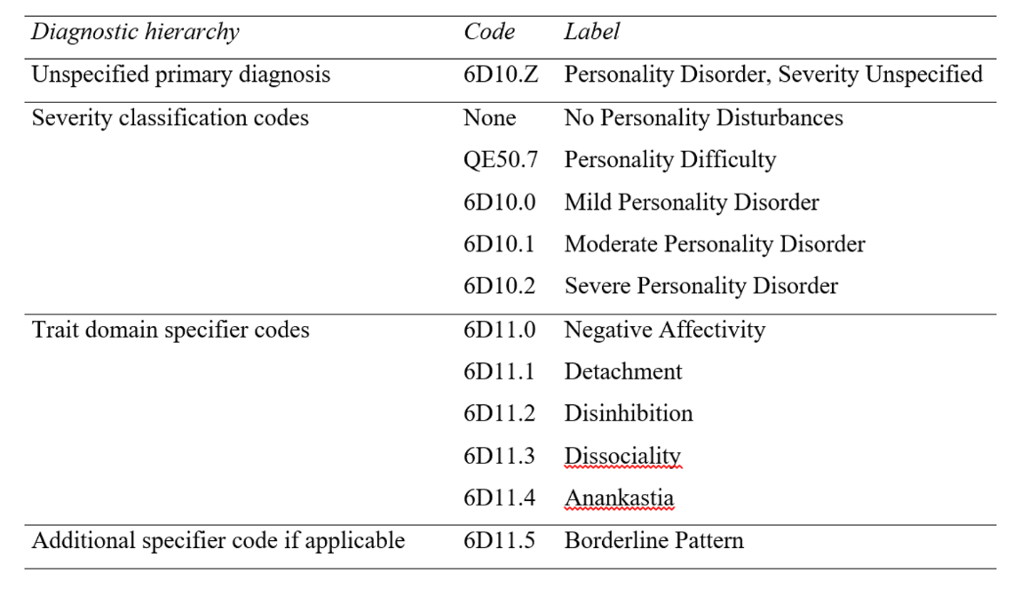
ICD11PD – Översikt

Slide 4
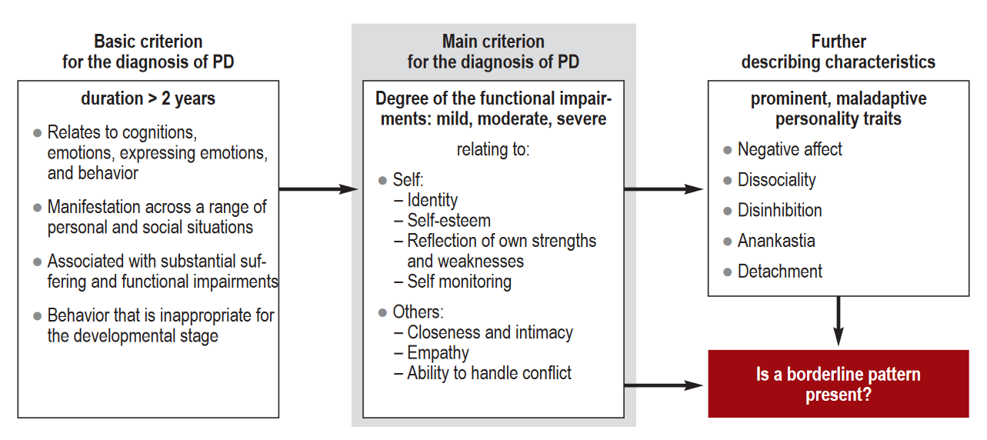
Personlighetssyndromdiagnostik enligt ICD-11
General diagnostic requirements
Traits Domain Charachterization
Severity Determination
Disturbance of the self
Interpersonal dysfunction
Emonal, cognitive and behavioral manifestations
Impairment and distress
Disturbance of the self
Interpersonal dysfunction
Emotional, cognitive and behavioral manifestations
Impairment and distress
Extended period of time (> 2yrs).
Patterns across a range of personal and social situations
Excluded other medical condition, condition Developmentally or culturrally appropriate
Adaptet from: Herpertz, S. et al., (2022). Patients With Personality Disorders in Everyday Clinical Practice. Deutsches Ärzteblatt International, 119(1–2), 1–7

Slide 5
DSM och ICD-11: likheter och skillnader
Generella diagnoskriterier enligt DSM-5:
A. Ett varaktigt mönster av upplevelser och beteenden som påtagligt avviker från vad som allmänt sett förväntas i personens sociokulturella miljö. Mönstret kommer till uttryck inom minst två av följande områden:
Kognitioner (d v s sättet att uppfatta och tolka sig själv, andra personer och inträffade händelser)
Affektivitet (d v s komplexiteten, intensiteten, labiliteten och rimligheten i det känslomässiga gensvaret)
Mellanmänsklig funktionsförmåga
Impulskontroll
B. Det varaktiga mönstret är oflexibelt och framträdande i många olika situationer och sammanhang.
C. Det varaktiga mönstret orsakar kliniskt signifikant lidande eller försämrad funktion socialt, i arbete eller inom andra viktiga funktionsområden.
D. Mönstret är stabilt och långvarigt och kan spåras tillbaka åtminstone till adolescensen eller tidig vuxenålder.
E. Det varaktiga mönstret förklaras inte bättre som ett uttryck för eller en följd av någon annan form av psykisk ohälsa.
F. Det varaktiga mönstret kan inte tillskrivas fysiologiska effekter av någon substans (t ex drog, läkemedel) eller något annat medicinskt (t ex skalltrauma).
Grunddefiniton enligt ICD-11:
An enduring disturbance characterized by problems in functioning of aspects of the self (e.g., identity, self-worth, accuracy of self-view, self-direction), and/or interpersonal dysfunction (e.g., ability to develop and maintain close and mutually satisfying relationships, ability to understand others’ perspectives and to manage conflict in relationships).
The disturbance has persisted over an extended period of time (e.g., lasting 2 years or more).
The disturbance is manifest in patterns of cognition, emotional experience, emotional expression, and behaviour that are maladaptive (e.g., inflexible or poorly regulated).
The disturbance is manifest across a range of personal and social situations (i.e., is not limited to specific relationships or social roles), though it may be consistently evoked by particular types of circumstances and not others.
The symptoms are not due to the direct effects of a medication or substance, including withdrawal effects, and are not better accounted for by another mental disorder, a Disease of the Nervous System, or another medical condition.
The disturbance is associated with substantial distress or significant impairment in personal, family, social, educational, occupational or other important areas of functioning.
Personality Disorder should not be diagnosed if the patterns of behaviour characterizing the personality disturbance are developmentally appropriate (e.g., problems related to establishing an independent self-identity during adolescence) or can be explained primarily by social or cultural factors, including socio-political conflict.

Slide 6
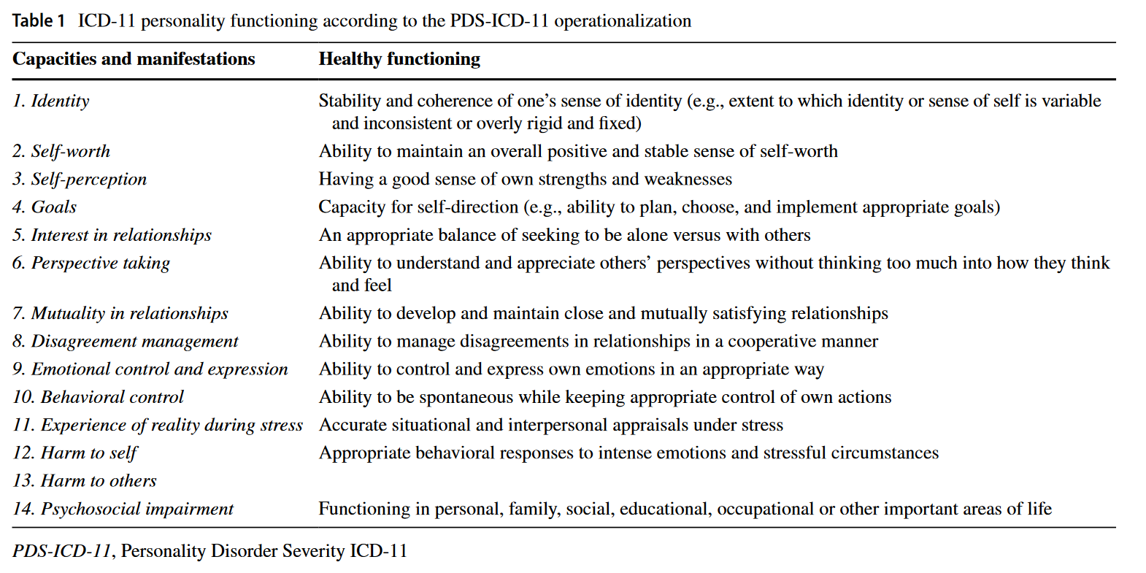
Identitet
Interpersonell funktion
Personlighetsrelaterade
symtom
Funktionsnedsättning
Källa: Mulder, R. (2025). Brit Med J, doi:10.1192/bjp.2024.169

Slide 7
Severe Personality Disorder
Domain | Main points
Disturbance of the self | Extremely unstable and/or contradictory self-view. Severe impairment in regulation of self-esteem. Inability to set or pursue realistic goals.
Interpersonal dysfunction | Often isolated. Relationships lack mutuality and are shallow or highly conflictual, often involving violence. Family relationships are absent or marked by severe and persistent conflict.
Emotional, cognitive and behavioral manifestations | Extreme difficulty recognizing or tolerating unwanted emotions. Severe impulse and behavior dysregulation. Under stress, extreme distortions in appraisal with frequent dissociative states or psychotic-like experiences.
Impairment and distress | Inability or unwillingness to sustain regular employment due to poor performance, interpersonal difficulties, or inappropriate behavior. Severe and pervasive distress across domains.

Slide 8
Moderate Personality Disorder
Domain | Main points
Disturbance of the self | Sense of self is highly unstable to stress or crisis. Marked instability of self-esteem, either chronically low or unrealistically inflated and resistant to correction.
Interpersonal dysfunction | Major limitations in perspective-taking. Relationships are persistently problematic, with frequent, intense, or volatile conflicts, or markedly unbalanced patterns (dominance or submission).
Emotional, cognitive and behavioral manifestations | Poor emotion regulation with strong reactions to setbacks. Either rapid disengagement from goals or rigid, unrealistic persistence. Under stress, marked distortions in appraisal, with possible dissociative states or psychotic-like experiences.
Impairment and distress | Occupational functioning significantly compromised, with limited engagement in sustained employment. Distress and functional impairment are moderate and pervasive across contexts.

Slide 9
Mild Personality Disorder
Domain | Main points
Disturbance of the self | Vulnerable sense of self and self-esteem with difficulty recovering from minor slights or failures; mismatch between self-view and others’ perceptions.
Interpersonal dysfunction | Limited capacity to understand others’ perspectives. Relationships marked by minor recurrent conflicts, dependency, or conflict avoidance, affecting emotional closeness.
Emotional, cognitive and behavioral manifestations | Problems with goal-setting and persistence, especially when facing small setbacks. Under stress, mild distortions in situational or interpersonal interpretation, with reality testing intact.
Impairment and distress | Occupational functioning largely preserved, though conflicts at work may occur. Overall impairment and distress are mild.

Slide 10
Personality Difficulty
Domain | Main points
Disturbance of the self | Slight instability in self-view or self-esteem; more sensitive to criticism than typical individuals.
Interpersonal dysfunction | Minor problems in perspective-taking or maintaining relationships; occasional but recurrent conflicts or dependency patterns.
Emotional, cognitive and behavioral manifestations | Some difficulty regulating emotions or pursuing goals under stress; mild distortions in thinking, less adaptive than usual.
Impairment and distress | Daily functioning generally intact, but small struggles may occur in work, school, or social life; distress is mild compared with normal variation.

Slide 11
Personality trait | Definition | Common manifestations (ex.)
Negative affectivity | A tendency to experience a broad range of negative emotions with a frequency and intensity out of proportion to the situation. | Emotional lability (over-reactivity, low tolerance) Poor emotion regulation (relationship-dependent) Negativistic attitudes Distrust
Detachment | A tendency to maintain interpersonal distance (social detachment) and emotional distance (emotional detachment) | Avoidance of social interactions (lack of enjoinment) Avoidance of intimacy (proximity avoidance) Limited emotional expression (emotional numbness) Reservedness Aloofness
Dissociality | Disregard for the rights and feelings of others, encompassing both self-centeredness and lack of empathy | Sense of entitlement (deserving) Recklessness in achieving own goals Manipulation (e.g. cold mentalization) Positive or negative attention-seeking behaviors (manipulation) Indifference to other´s reactions and emotional states (cynicism)
Disinhibition | A tendency to act rashly based on immediate external or internal stimuli (i.e., sensations, emotions, thoughts), without consideration of potential negative consequences. | Impulsivity (difficulty in delaying) Distractibility Irresponsibility Recklessness Lack of planning
Anankastia | A narrow focus on one’s rigid standard of perfection and of right and wrong, and on controlling one’s own and others’ behaviour and controlling situations to ensure conformity to these standards. | Perfectionism (concern with social rules, obligations, and norms of right and wrong) Inflexibility Emotional constrain Risk-avoidance Perseveration
Notes:
Anankastia and dishinibition my represent opposite poles of the same higher order domain

Slide 12
Personality trait | Definition
Borderline pattern | The Borderline pattern descriptor may be applied to individuals whose pattern of personality disturbance is characterised by a pervasive pattern of instability of interpersonal relationships, self-image, and affects, and marked impulsivity, as indicated by many of the following: Frantic efforts to avoid real or imagined abandonment A pattern of unstable and intense interpersonal relationships Identity disturbance, manifested in markedly and persistently unstable self-image or sense of self A tendency to act rashly in states of high negative affect, leading to potentially self-damaging behaviours Recurrent episodes of self-harm Emotional instability due to marked reactivity of mood Chronic feelings of emptiness Inappropriate intense anger or difficulty controlling anger Transient dissociative symptoms or psychotic-like features in situations of high affective arousal.

Slide 13
Personlighetsspektrum
Funktioner
Att etablera, utveckla och behålla ömsesidiga mellanmänskliga relationer
Att uppleva sig själv som integrerad, koherent och konsekvent
Att skaffa sig och fungera i samhällets förväntade roller
Dimensioner
Subkliniskt/
Prekliniskt
Psykiatrisk Diagnos
Interpersonell störning
Dysfunktionell personlighet
Identitetsstörning
Personlighets-
syndrom
Maladaptivt beteende

Slide 14
"Är det en störning – eller bara en svårighet?"
Clinical
Severity
Subclinical
Nomal variation
Time

Slide 15
Vårdplanering baserad på ICD-11
Alla med PS kan hamna i allvarlig kris – risken gäller alla nivåer!
Svårighetsgrad = återhämtningsförmåga, inte risknivå.
Svårighetsgrad | Typ av kris | Fokus i vårdplan
Personlighets-svårighet | Kortvarig, självupplösande kris | Anpassning till utlösande faktorer
Mild PS | Avgränsade episoder, söker hjälp efteråt | Autonomi, coping, självhjälp
Måttlig PS | Upprepade kriser, söker hjälp i akutskede | Krisstöd, förebygg eskalation
Svår PS | Kontinuerlig kris, låg tröskel, ambivalens | Proaktiv hantering, samordnat stöd
In press. Di Leone, F.G., Liljedahl, S.I., Self-Harm and Global Aspects of Personality Disorder, in Bach, B. (ed.). ICD-11 Personality Disorders: Assessment and Treatment. Oxford University Press.

Slide 16
Behöver det verkligen vara en personlighetsutredning?
Standardised Assessment of Personality (SAP) -Abbreviated Scale (Moran)
Please ask your patients the following questions. Only tick a response if the patient
thinks that the description applies most of the time and in most situations.
1. In general, do you have difficulty making and keeping friends?  Yes  No
2. Would you normally describe yourself as a loner?  Yes  No
3. In general, do you trust other people?  Yes  No
4. Do you normally lose your temper easily?  Yes  No
5. Are you normally an impulsive sort of person?  Yes  No
6. Are you normally a worrier?  Yes  No
7. In general, do you depend on others a lot?  Yes  No
8. In general, are you a perfectionist?  Yes  No
Responses in bold should be scored as 1, those not in bold as 0.
A total score of 3/8 or more indicates personality disorder is likely. (A score of 3 or
more on this tool correctly identied 90% of psychiatric patients with DSM-IV
personality disorder. Sensitivity 0.94 and specificity 0.85).

Slide 17
Instrument för PS diagnostik enligt ICD-11
Typ | Instrument | Format / Poängsättning | Kommentar
Svårighetsgrad (Severity inventories) | PDS-ICD-11 – Självrapport | 14 frågor, bedöms av patient/klient | Bedömer svårighetsgrad av personlighetssyndrom
 | PDS-ICD-11 – Klinikers version | 14 frågor, bedöms av kliniker | Samma som ovan men för professionell bedömning
Draginventarier (Trait inventories) | Personality Inventory for ICD-11 (PiCD) | 60 frågor, 5 dragdomäner | Självrapport, mäter personlighetsdrag enligt ICD-11
 | Informant Personality Inventory for ICD-11 (IPiC) | 60 frågor, 5 dragdomäner | Bedöms av närstående/informant
 | Five-Factor Inventory for ICD-11 (FFiCD) | 121 frågor, 5 domäner, 20 facetter, 47 nyanser | Omfattande dragbedömning
 | Personality Assessment Questionnaire – ICD-11 traits, Revised (PAQ-11R) | 17 frågor, 5 dragdomäner | Kort och lättanvänt
 | Personality Inventory for DSM-5 & ICD-11 – Kort form, Modifierad | 36 frågor, 6 dragdomäner, 18 facetter | Kombinerad DSM-5/ICD-11-version
 | Personality Inventory for ICD-11 – Kort form, Modifierad | 30 frågor, 5 dragdomäner, 15 facetter | Kort form för endast ICD-11
Fullständiga intervjuer (Full interviews) | DIPP-11 – Diagnostic Interview for Personality Pathology in ICD-11 | Kommande diagnostiskt intervju (under utveckling) | Standardiserad intervju för klinisk bedömning
Alla dessa instrument finns tillgänglig på personlighed.dk

Slide 18
Principer för Differentialdiagnostik enligt ICD-11-PS
Personlighetssyndrom är en exklusionsdiagnos:
Personlighetssyndrom utesluter inte andra diagnoser.
Men andra tillstånd kan ibland utesluta ett personlighetssyndrom.
Anpassad från: WHO (2023). Clinical descriptions and diagnostic requirements for ICD-11 mental, behavioural and neurodevelopmental disorders (CDDR)
Psykisk ohälsa förändrar personlighetens uttryck!
Personlighetsvariationer finns på ett spektrum = påverkas av livsomständigheter och omgivningsstöd!

Slide 19
Och DSM-5-AMPD då?
“We recommend that the APA aligns the DSM-5 with the ICD-11 without losing any important aspects of the AMPD that have been empirically validated over the last decade or of the current categorical model.”
DSM-6?
Hybriddiagnosen tas bort – ersätts av valfria mönsterspecifikationer
Svårighetsgrad (LPF) blir linjär och inkluderar mild nivå
4-gradig skala för personlighetsdrag (Kriterium B)
Ny dragdomän: Tvångsmässighet (Anankastia)
Sharp, C. et al., 2025

Slide 20
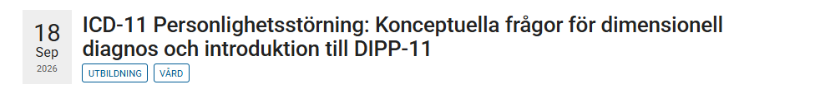
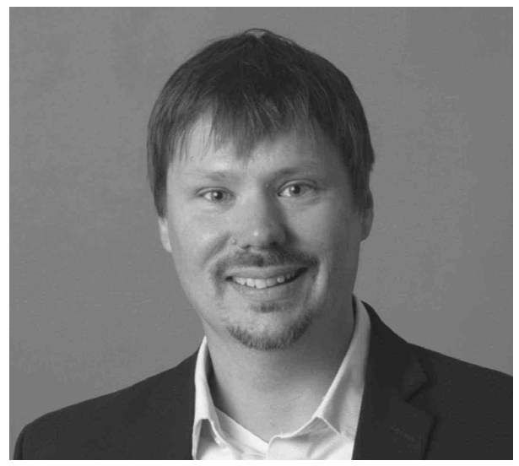
Save the date!
Martin Sellbom är professor i psykologi vid Monash University i Melbourne. Hans forskning fokuserar på personlighetssyndrom, modern psykopatologi och personlighetsbedömning, särskilt med MMPI‑instrument. Han har publicerat över 350 vetenskapliga arbeten, inklusive fyra böcker, mottagit flera internationella utmärkelser och är chefredaktör för Journal of Personality Assessment. Sellbom är legitimerad klinisk psykolog i Australien och Nya Zeeland och specialiserar sig kliniskt på rättspsykologiska utredningar.

Slide 21
Tack!
flavio.di.leone@vgregion.se
www.linkedin.com/in/flaviodileone

